Slide 1
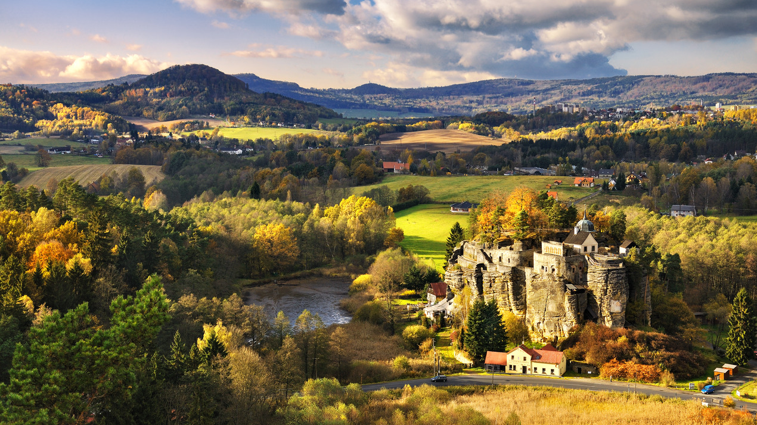
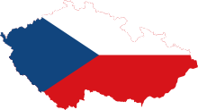
CZECH REPUBLIC
The Ultimate Survival Guide

Slide 2
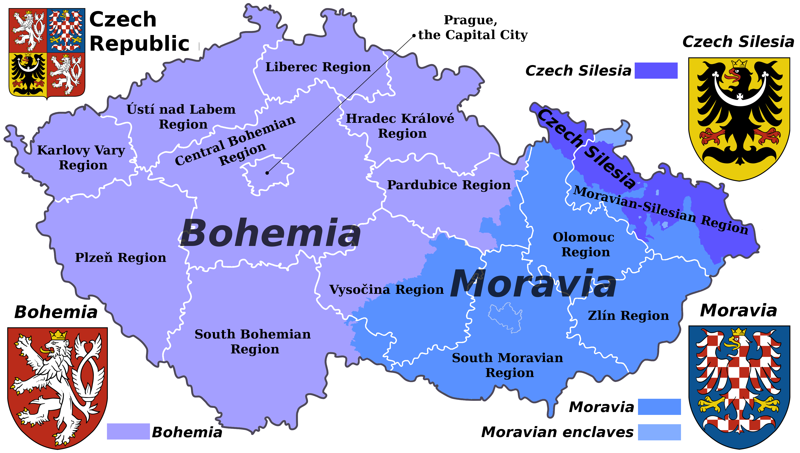

Slide 3
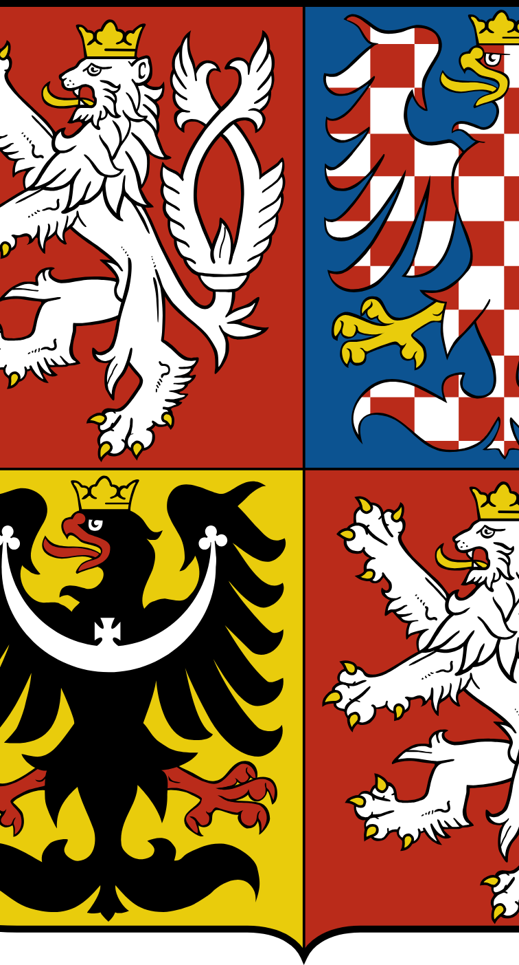
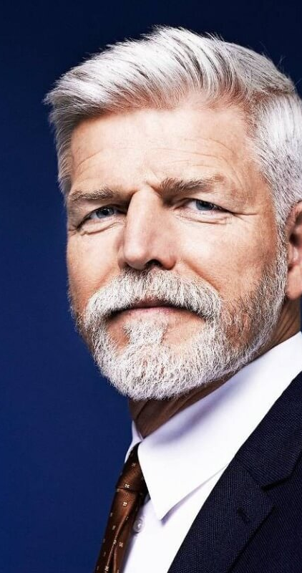
BASIC FACTS
Czech Republic since 1993 (formerly Czechoslovakia)
10.5 million inhabitants
Located in Central Europe
3 historical parts (Bohemia, Moravia, Silesia) and 14 regions (including Prague)
Parliamentary democracy,
president: Petr Pavel
Currency- Czech Crown
(1 Euro= 25 Kč)
Official Language: Czech

Slide 4

TRAVEL TIPS

Slide 5
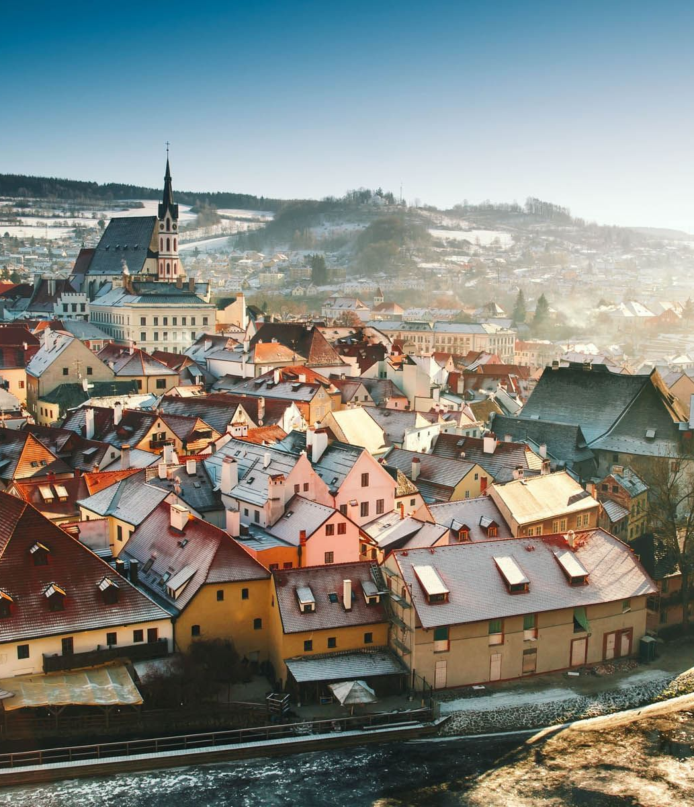
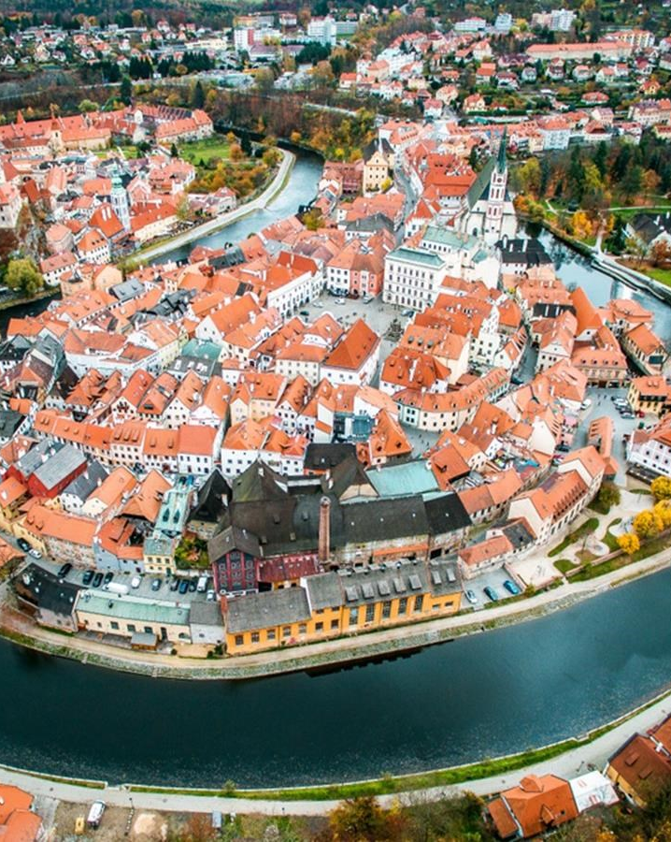
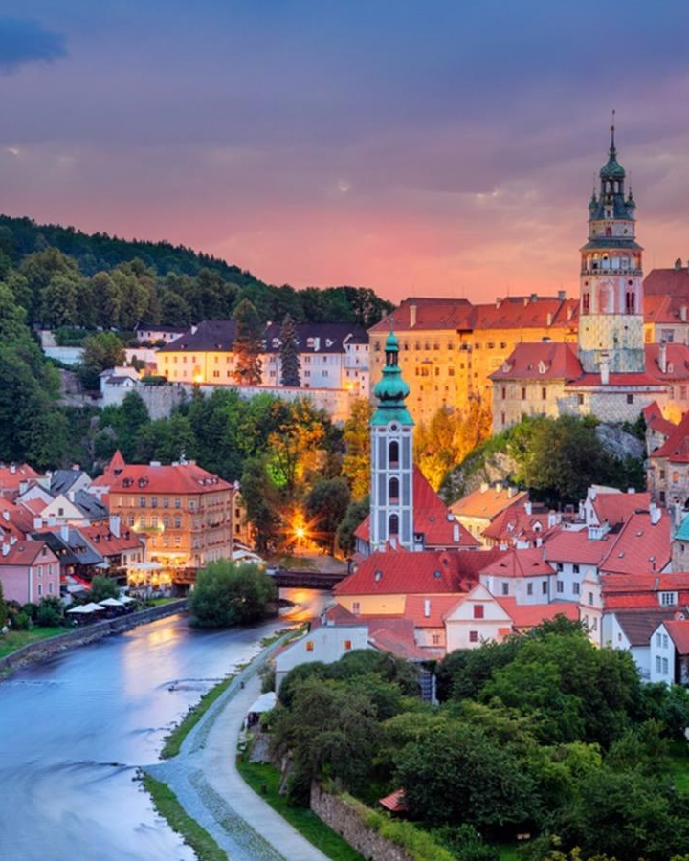
ČESKÝ KRUMLOV
FamilyID=Office_ArchiveTorn
UNESCO, one of the most picturesque towns in CR
Historical centre is completely surrounded by Vltava river
Medieval castle with a bear zoo, many museums

Slide 6
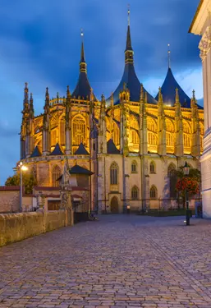
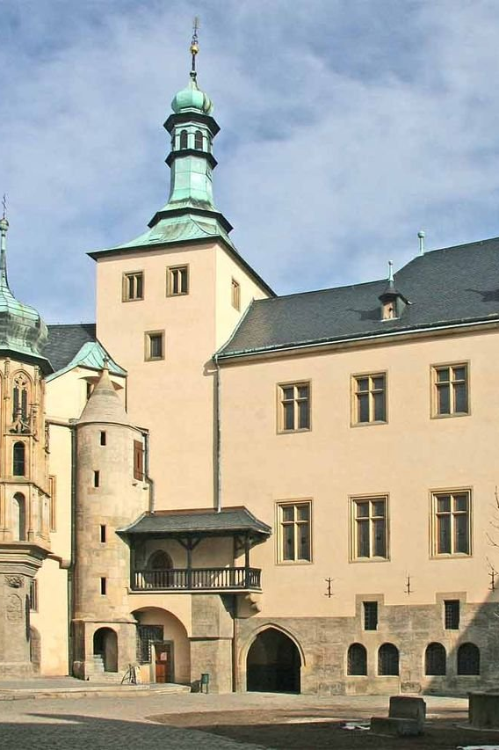
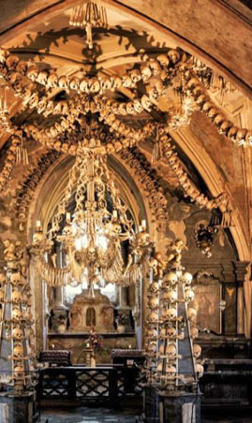
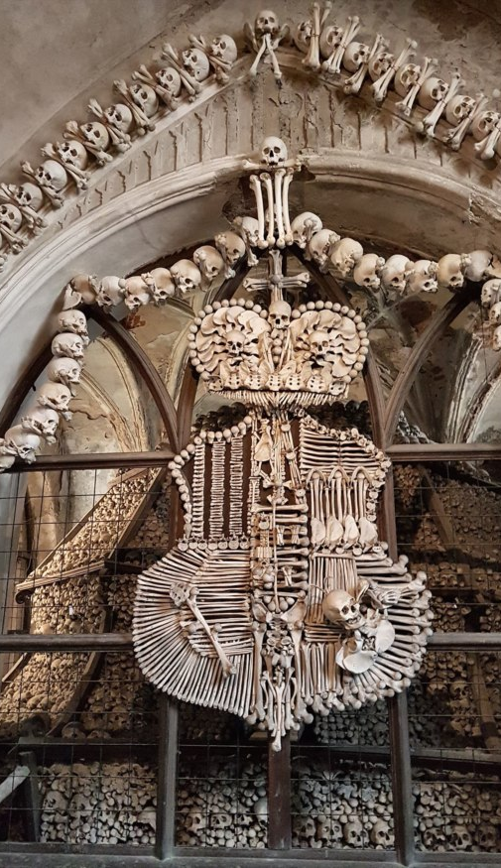
KUTNÁ HORA & SEDLEC OSSUARY
Large gothic cathedral of St. Barbora from the 13th century
Former silver mining town- still can visit the mines
Kostnice- contains skeletons of about 50.000 people, whose bones have been artistically arranged to form decorations and furnishings for the chapel

Slide 7
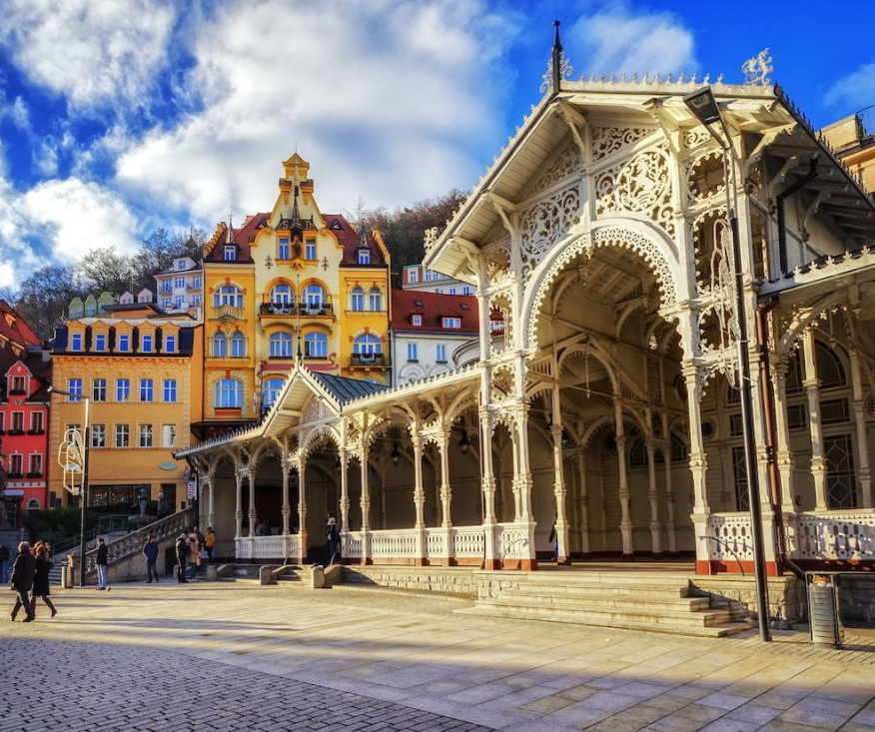
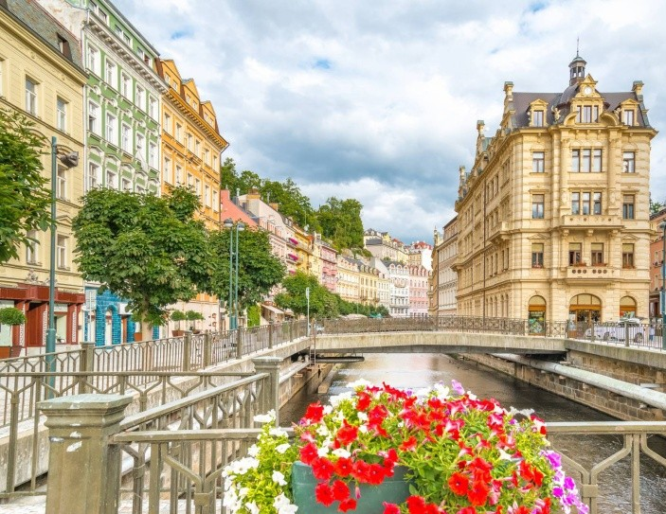
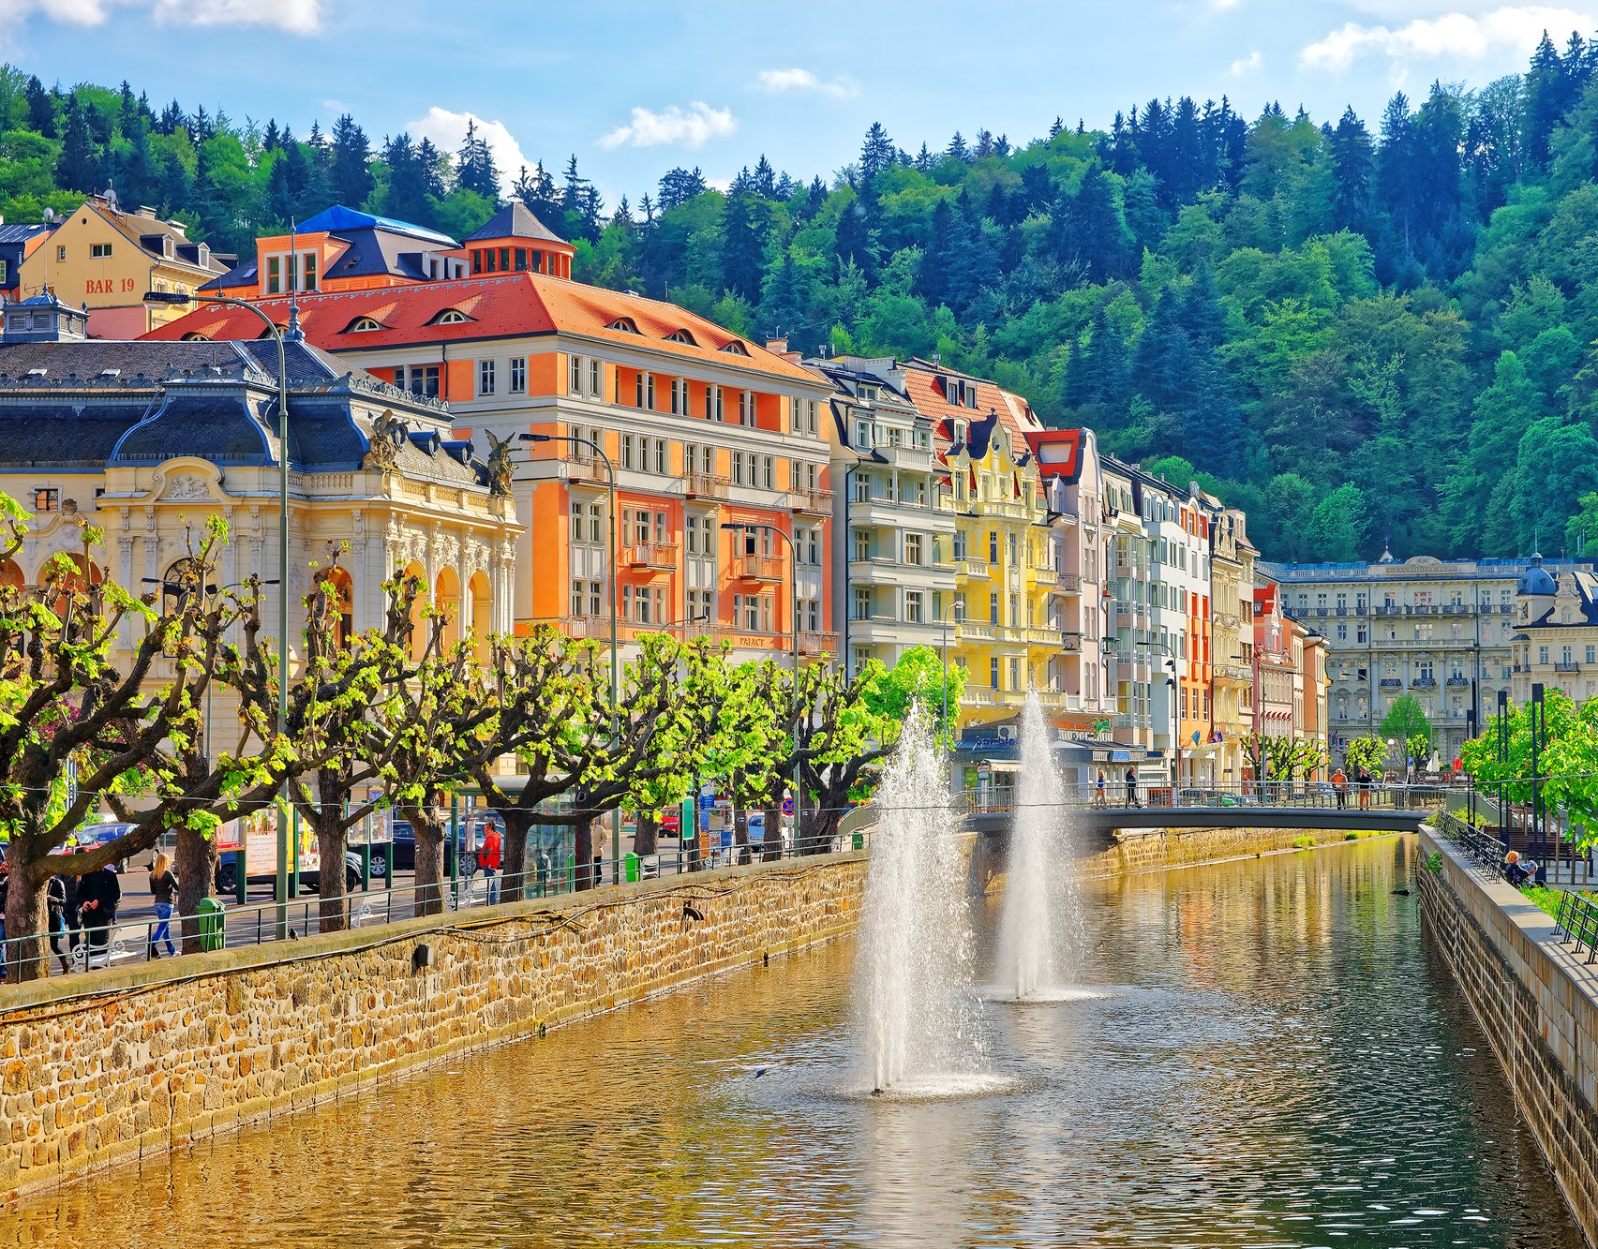
KARLOVY VARY
Czech Spa town, founded by – you guessed it- Charles the fourth
largest spa complex in Europe, includes numerous hot springs and a large wooden colonnade
You can walk around the town and drink from the springs- said to have many health benefits
Hosts an annual International film festival which previously included guests such as Uma Thurman, Robert Pattinson or Scarlett Johansson

Slide 8
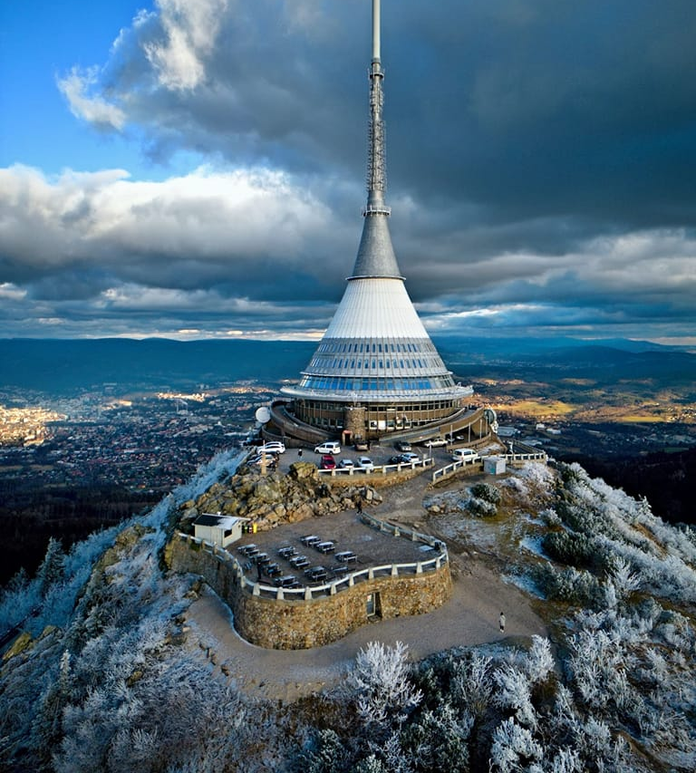
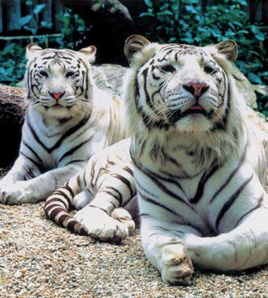
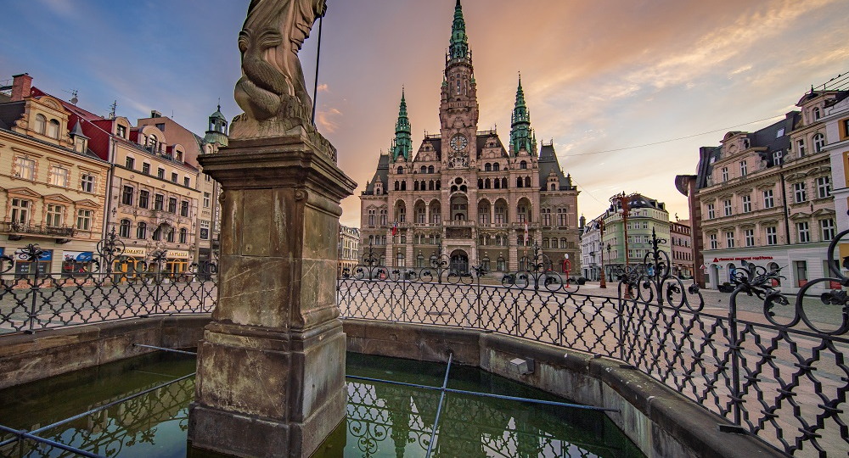
LIBEREC
North of CR, beautiful town hall
Zoo is famous for white tigers
IQ Landia science park
Close to the Jizera mountains, can climb up to Ještěd to see the tower

Slide 9
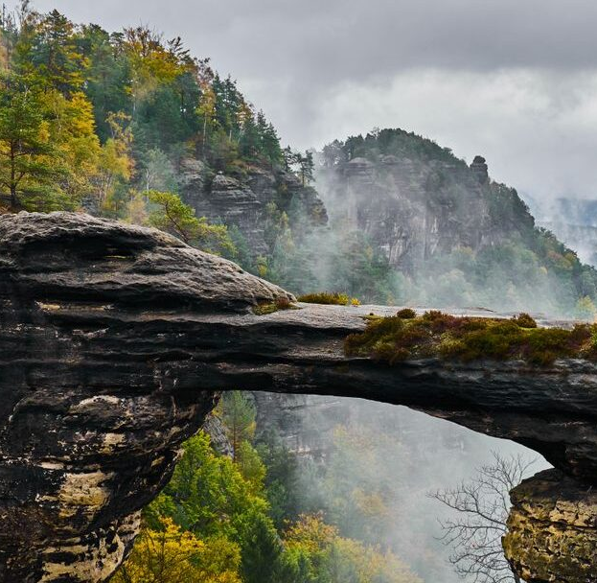
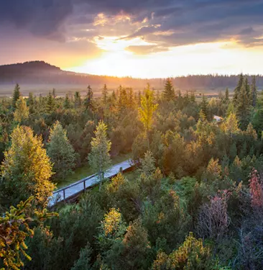
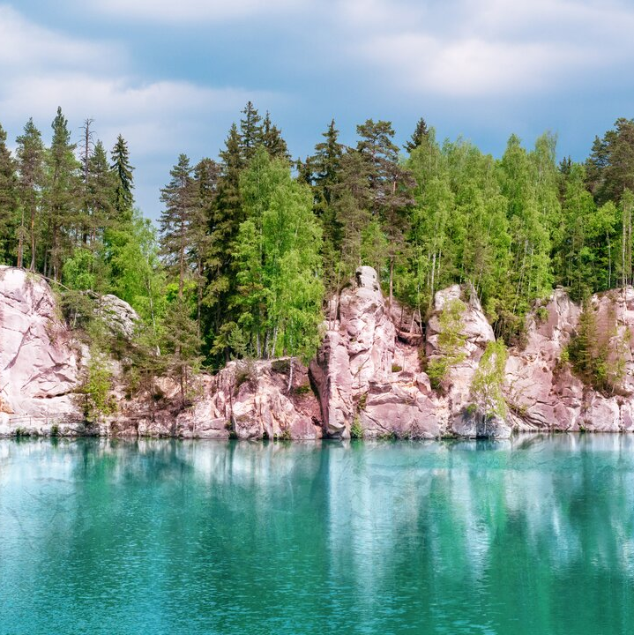
NATURE
Bohemian Switzerland, Šumava, Adršpach

Slide 10
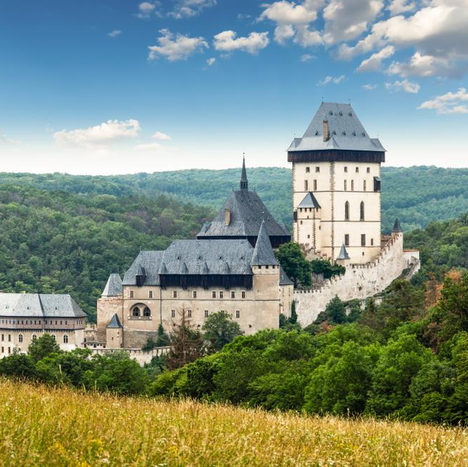
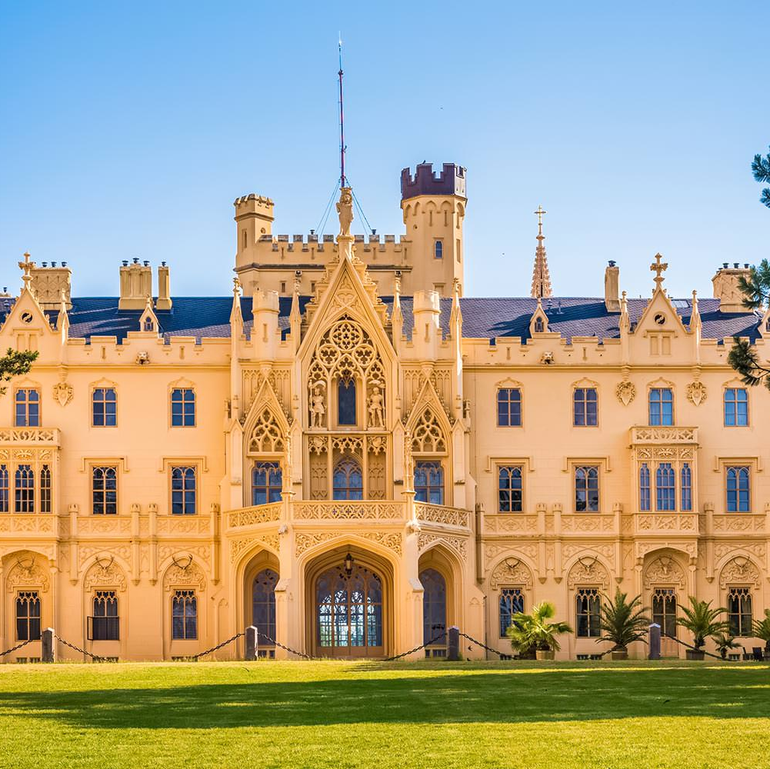
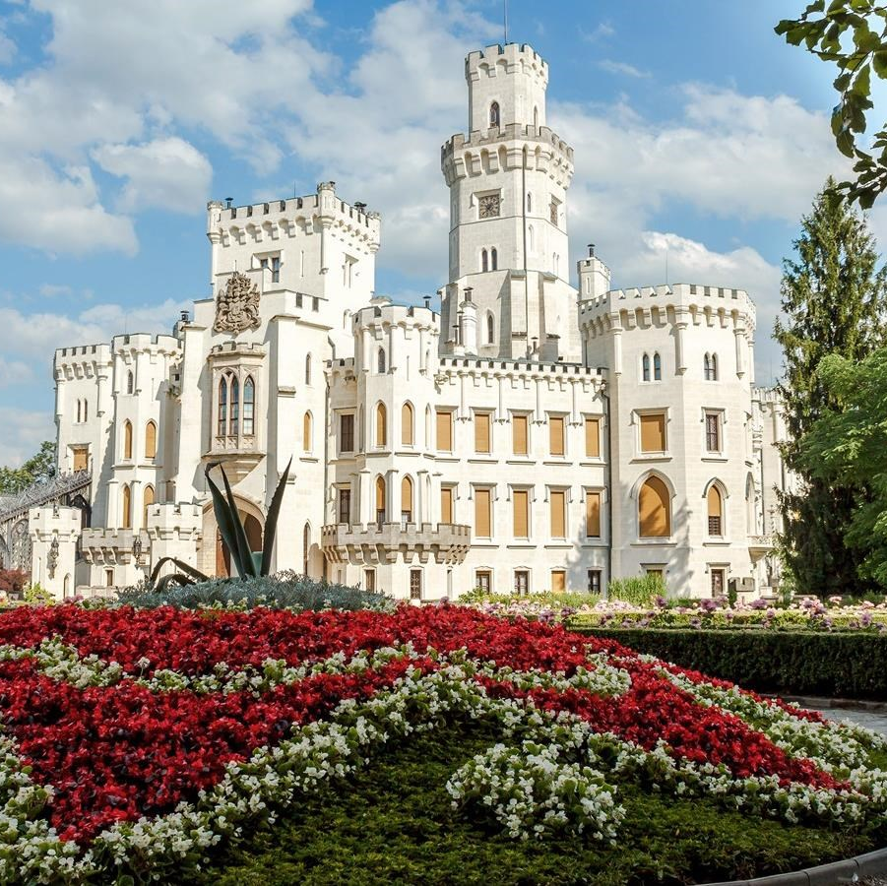
CASTLES
Czech Republic has over 2000 castles and chateaux and is said to have the highest density of castles in the world
usually includes a guided tour
Karlštejn
Lednice-Valtice Chateau complex
Hluboká nad Vltavou

Slide 11
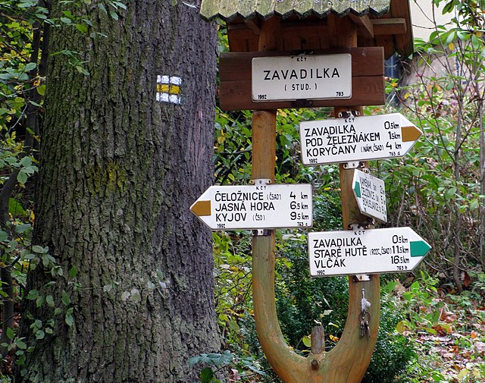
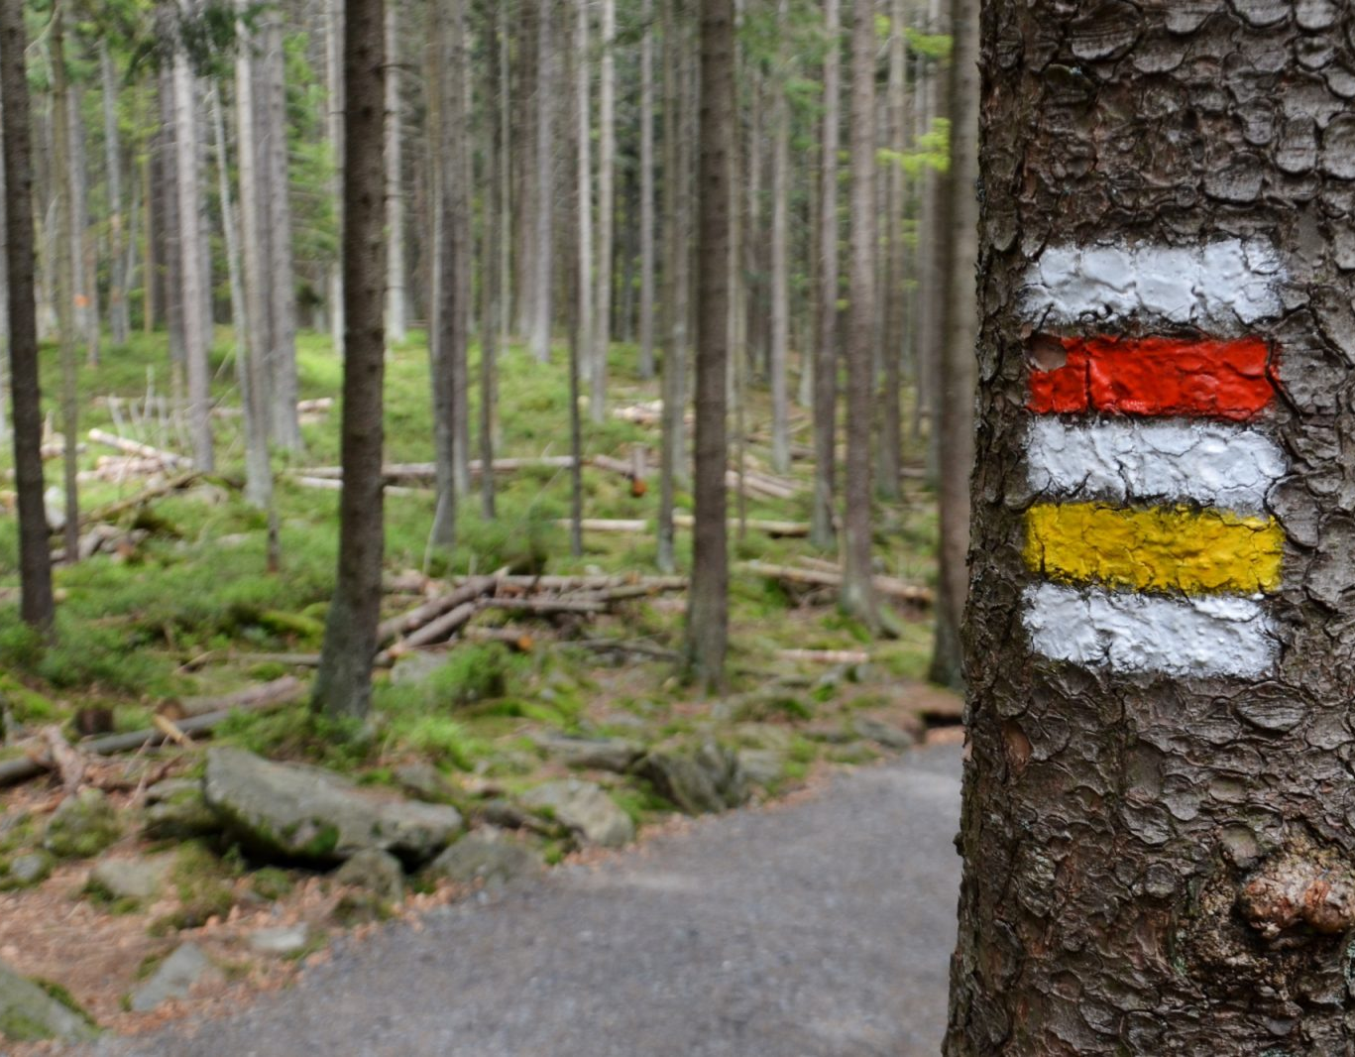

TIPS FOR TRAVELLING
Get inspiration from:
https://www.instagram.com/kamnavylet.cz/?hl=cs or https://www.visitczechia.com/
While in nature, you can always follow the tourist markings (on trees, stones, to mark crossroads)

Slide 12
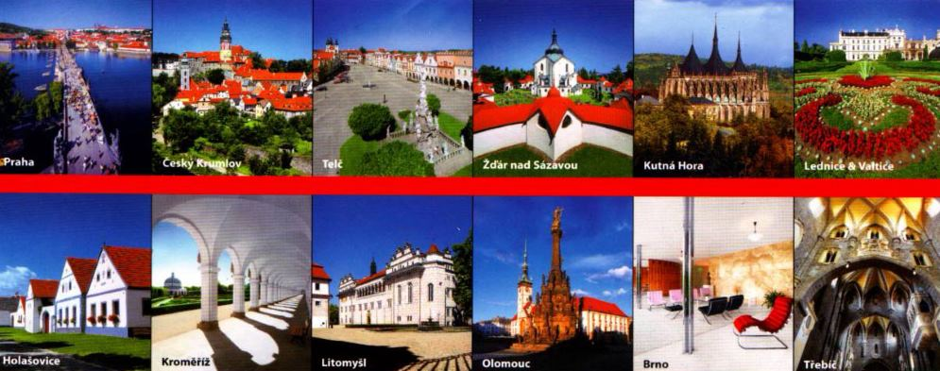
UNESCO WORLD HERITAGE SIGHTS

Slide 13
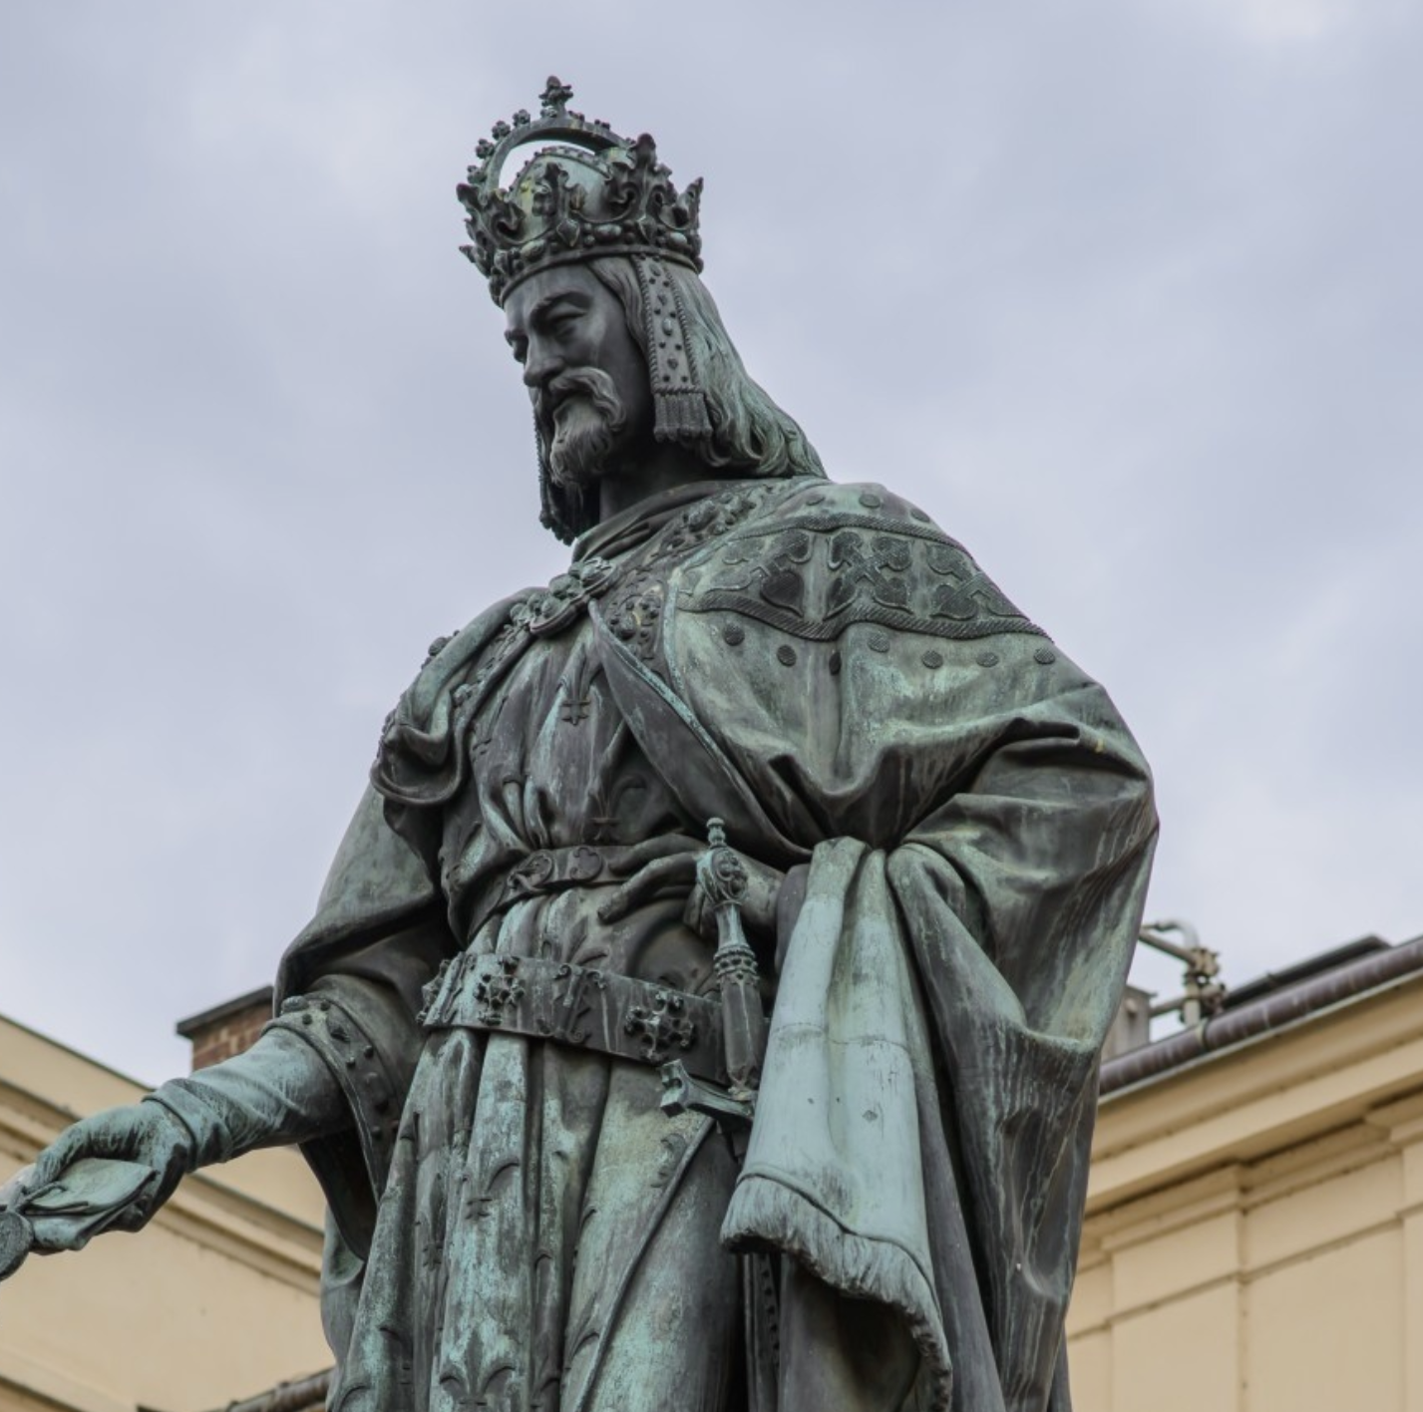
HISTORY
Boii Celtic tribe in the 4th century-> name Bohemia, replaced by Slavic tribes
Přemyslid dynasty in the 9th century
Golden age during the reign of the Holy Roman emperor Charles the Fourth
Hussite wars in the 15th century against Catholic forces
Part of the Austria-Hungarian empire until it was broken down at the end of WW1
Czech national revival during the 19th century

Slide 14
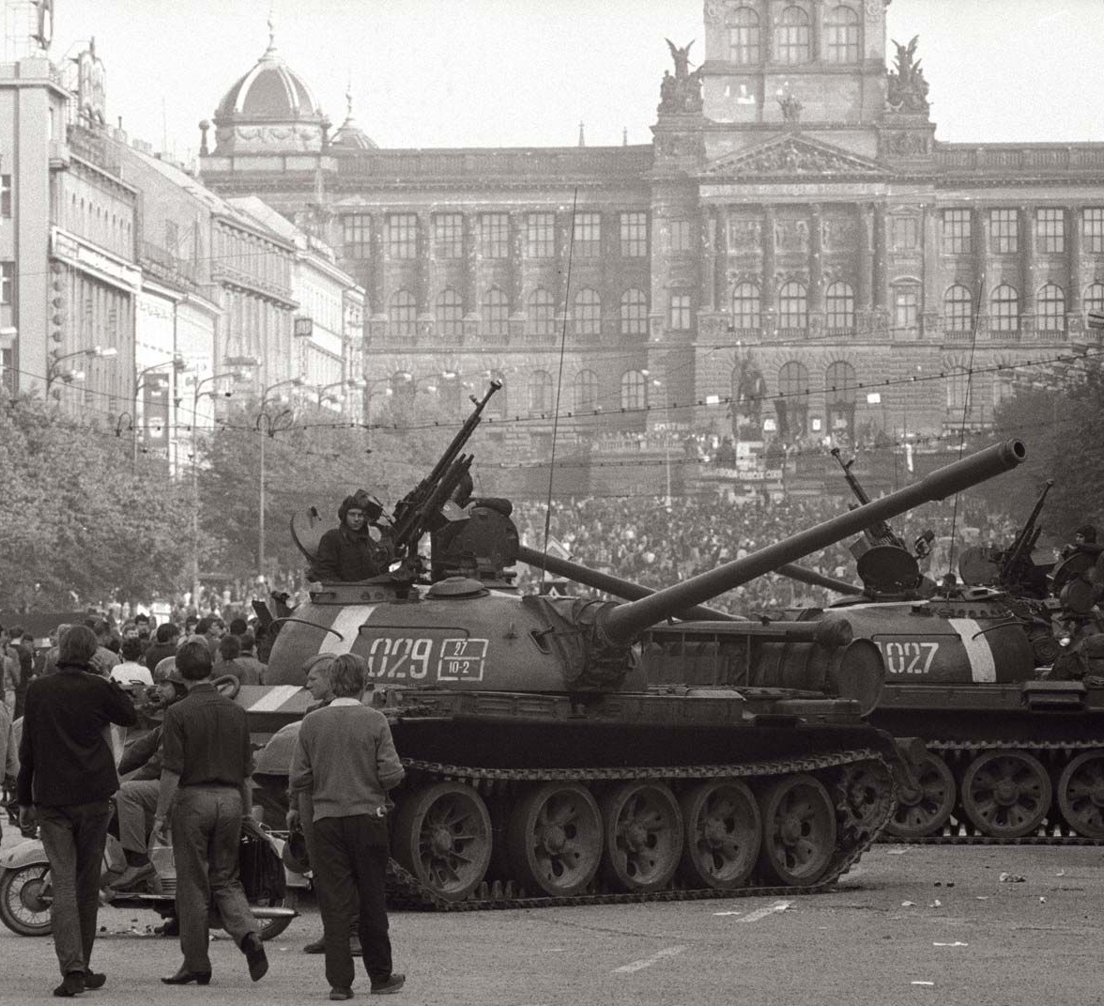
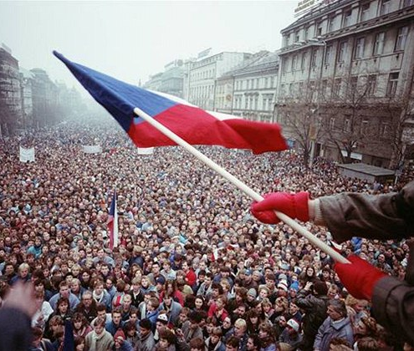
MODERN HISTORY
Czechoslovakia founded on 28th of October 1918
Period of first republic- major economic player, second „golden age“
Cut short in September 1938 when the Munich agreement was signed and we came to be ruled by the third reich
Communist era, under the Soviet sphere of power from February 1948 to November 1989
1968- Prague Spring
1989- Velvet revolution-> became a democratic country
1993- dissolution of Czechoslovakia
2004- member of the EU

Slide 15
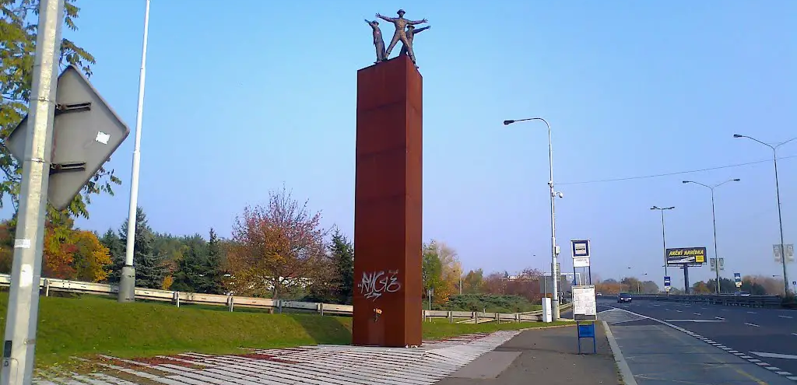
Heydrich‘s Curve
Attempted assassination of the reich protector Reinhard Heydrich during the nazi occupation in June 1942
Anthropoid- movie about the operation

Slide 16
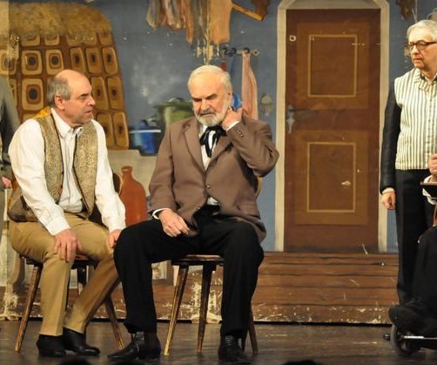
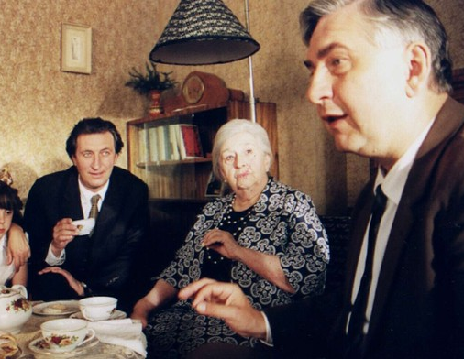
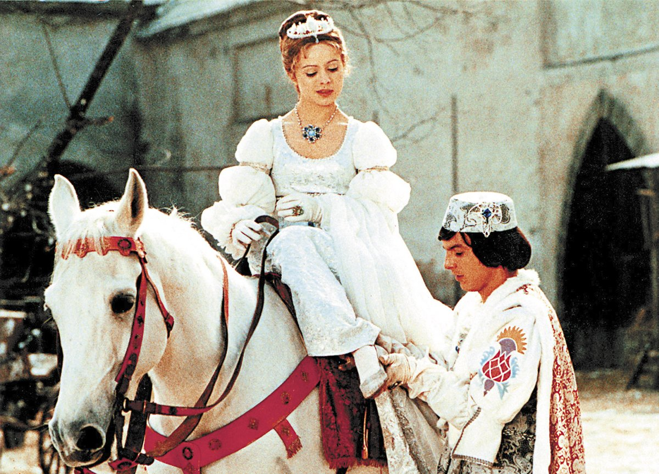
CZECH CULTURE
Cozy Dens („Pelíšky“) – a cult movie, depicts the reality of life under communism, seen as a comedy but actually has quite dark themes (which is typical for Czech movies)
Divadlo Járy Cimrmana – theatre dedicated to the works of the most famous Czech author and inventor- great satire, lots of lore to get into (check out the Wikipedia page!)
Other movie recommendations: Kolja, The Elementary School, Šarlatán (available on Netflix)
Fairy tales- staple of Czech culture, one movie released on Christmas every year, Tři oříšky pro Popelku (1970s Cinderella), Anděl Páně

Slide 17
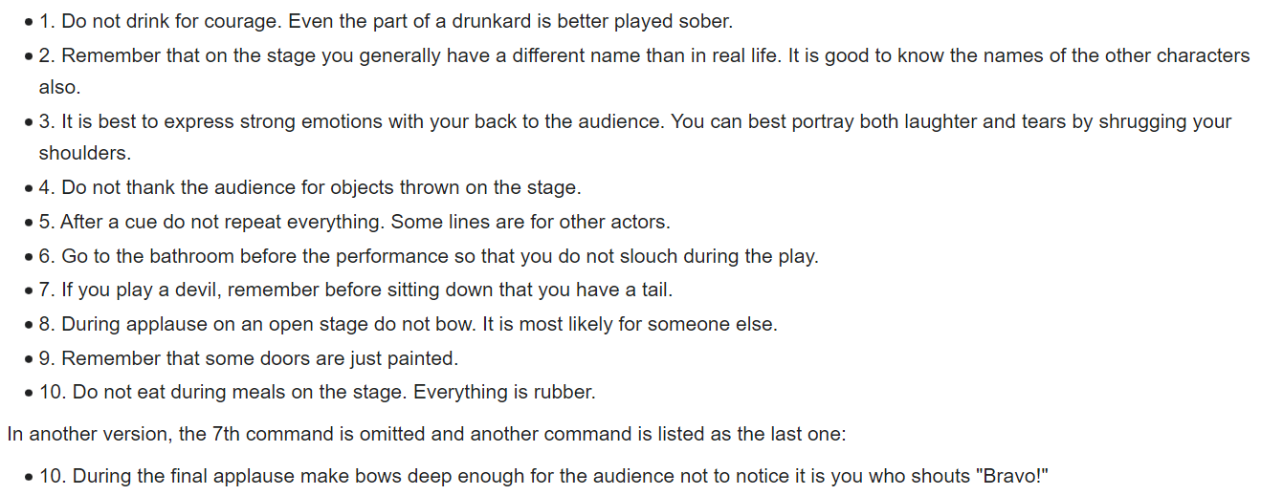
CIMRMAN‘S 10 RULES FOR NOVICE ACTORS

Slide 18
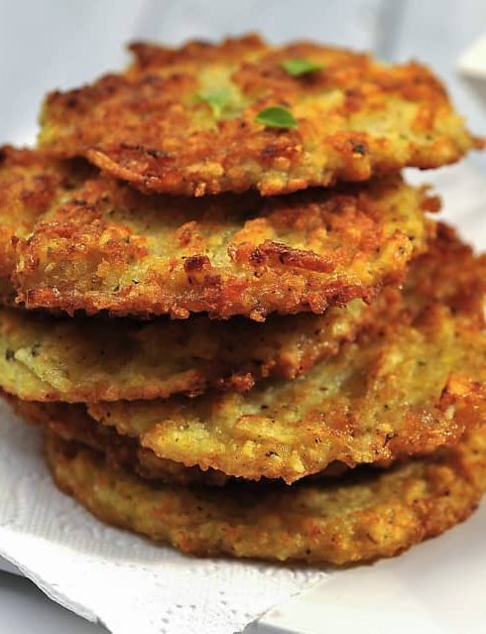
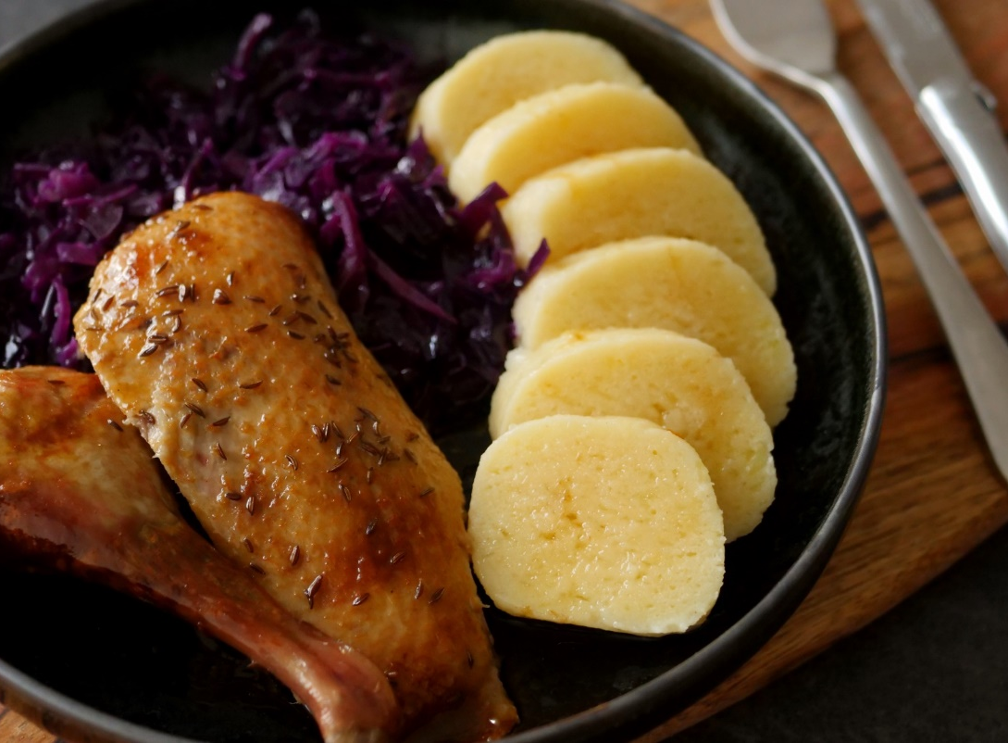
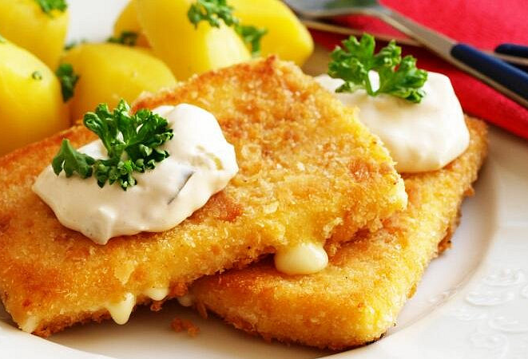
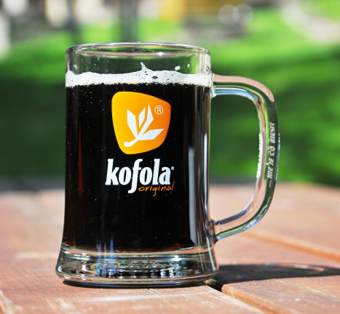
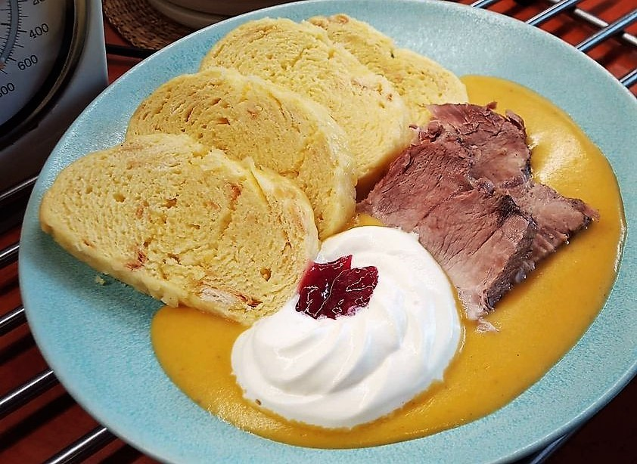
CZECH FOOD
Really tasty but not the healthiest option
Trdelník/Chimney cake is actually Hungarian and kind of a tourist trap, certainly not a „medieval Czech recipe“
Kofola- the (far superior) Czech version of Coke, best on the tap, Malinovka
Dumplings- potato or bread roll based
Fried cheese, Řízek (schnitzel), Svíčková (Roast Sirloin in Sour Cream Sauce), Roasted duck with dumplings and cabbage, bramboráky (potato pancakes)

Slide 19
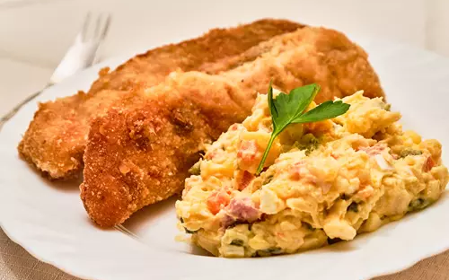
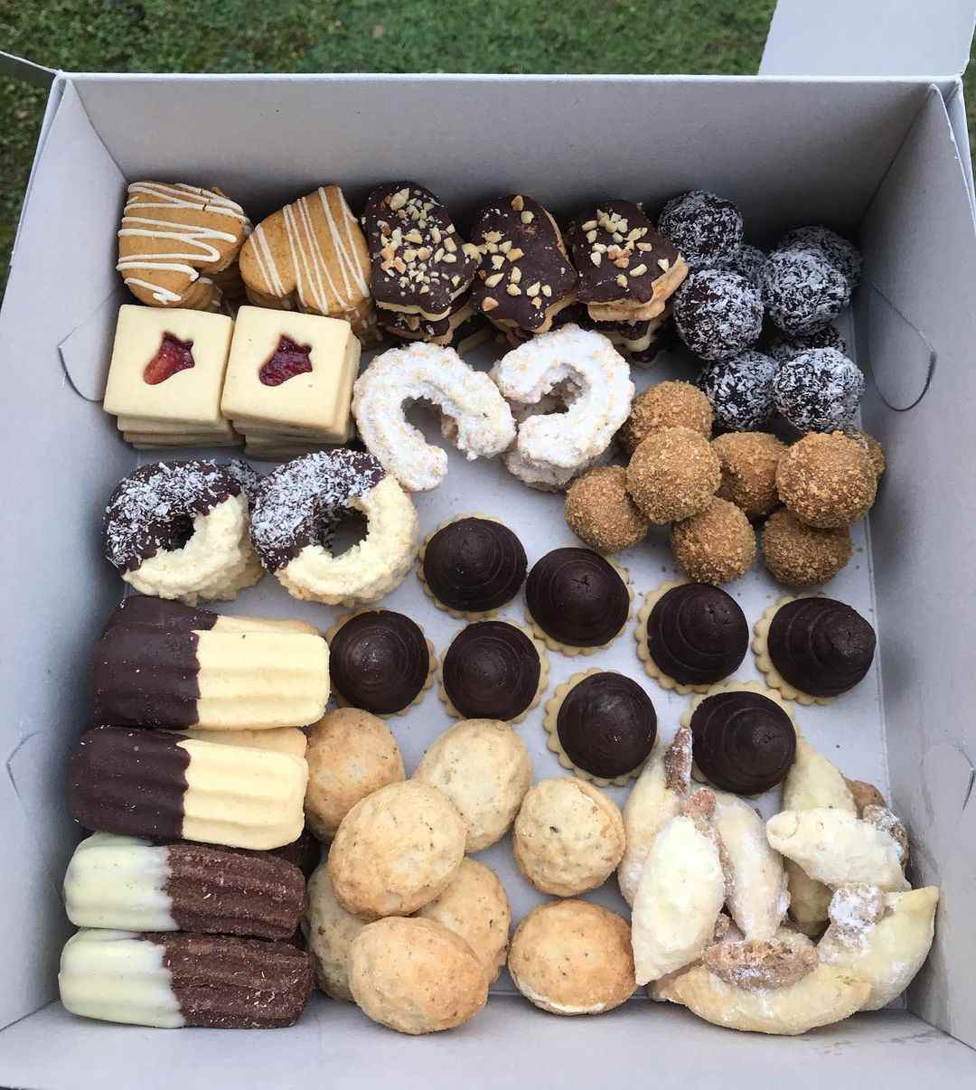
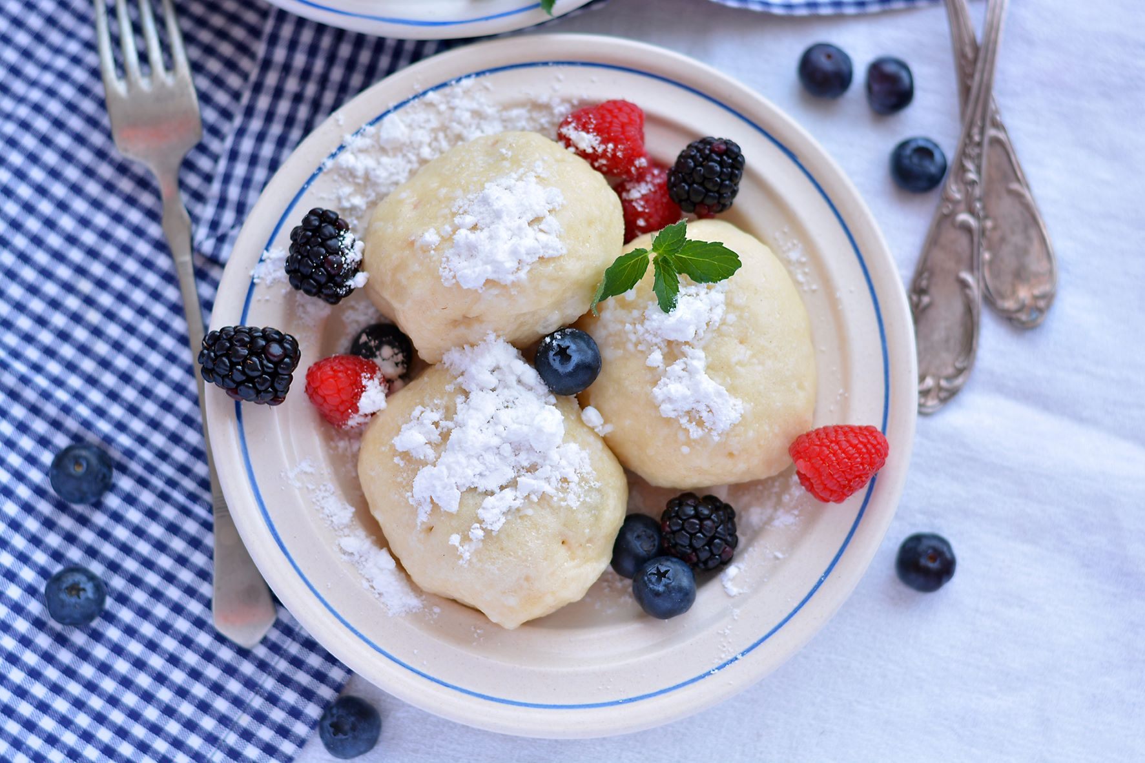
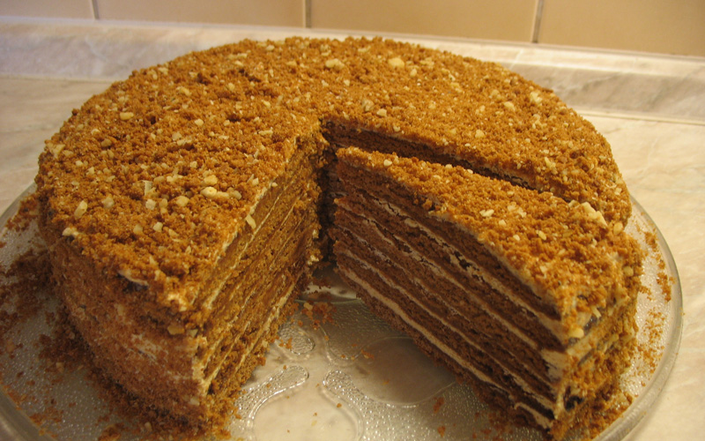
CZECH FOOD II.
Czechs tend to have a sweet tooth:
Fruit dumplings
Medovník (Honey layered cake), can be bought in the supermarket
Štrůdl (apple pie with raisins)

Slide 20
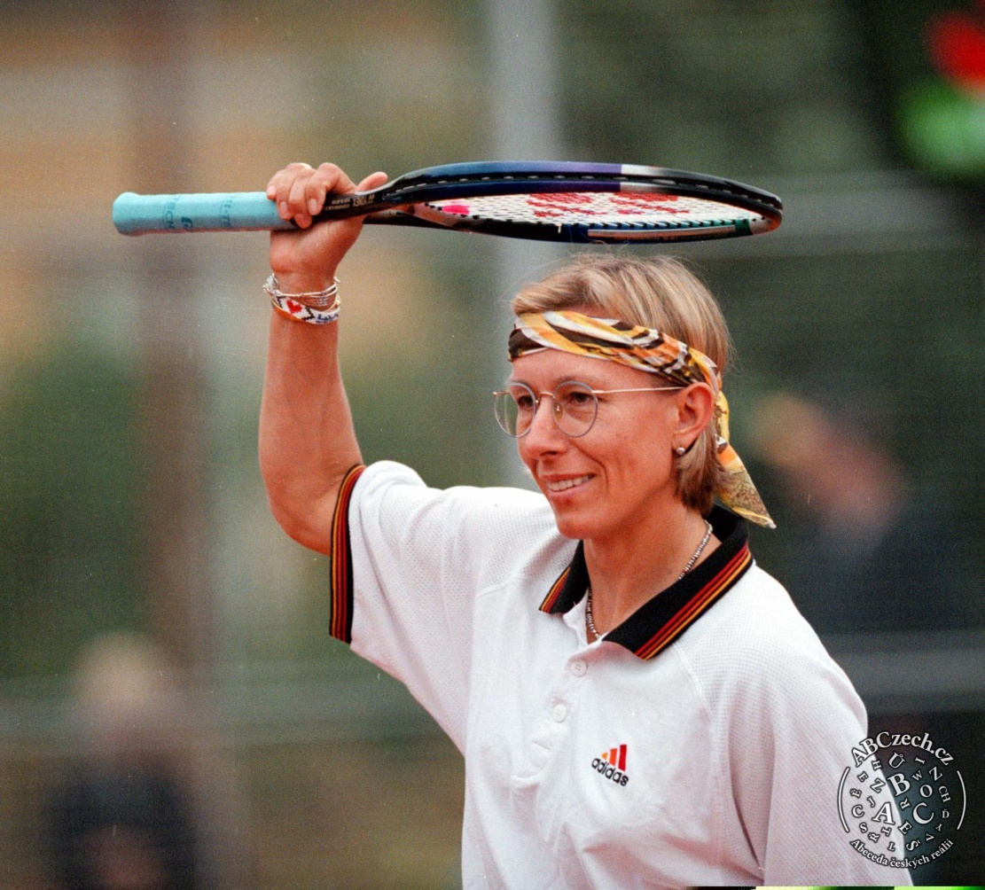
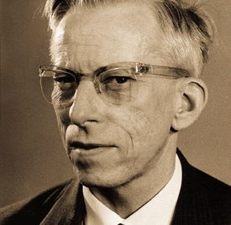
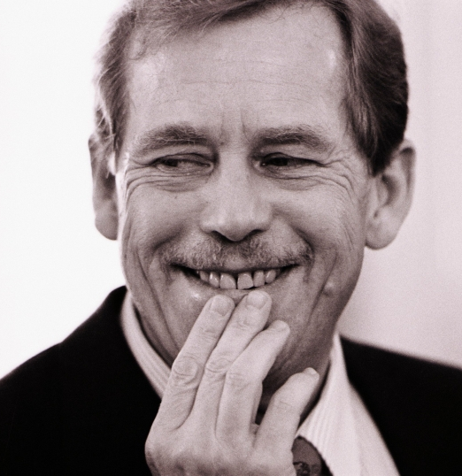
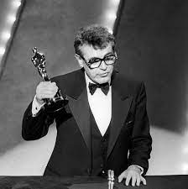
FAMOUS CZECHS
Miloš Forman- Academy Award winning director, famous for One Flew Over the Cuckoo‘s Nest and Amadeus
Otto Wichterle- scientist, improved contact lenses
Václav Havel- playwright and the first Czech president, leading figure of the Velvet revolution
Martina Navrátilová- one of the world‘s best female tennis players

Slide 21
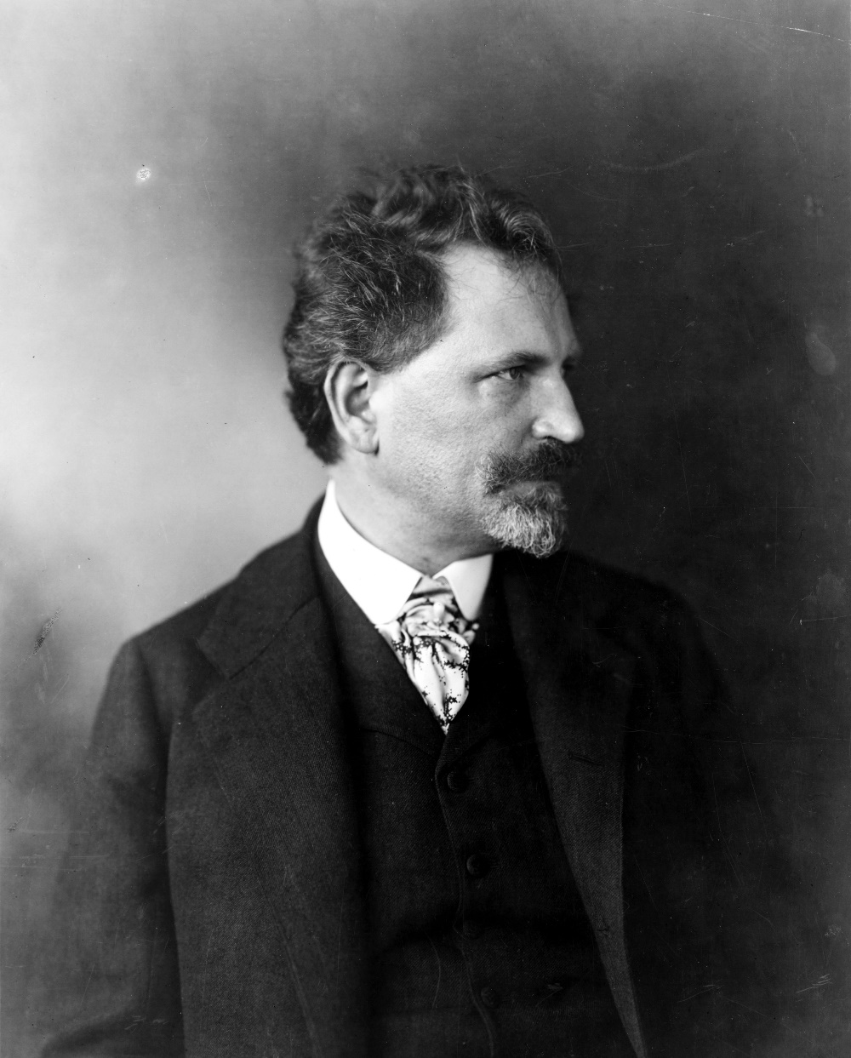
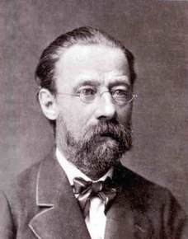


FAMOUS CZECHS II.
Bedřich Smetana – composer, author of Vltava
Alfons Mucha- art noveau painter, poster designer
Franz Kafka – wrote in German- Metamorphosis, The Trial
Milan Kundera- writer, famous for Unbearable Lightness of Being

Slide 22

Czech inventions include the word „robot“ (Karel Čapek), sugar cubes, discovery of blood types and laws of heredity as well as soft contact lenses

Slide 23






Slide 24

CZECH PEOPLE
Some stereotypes include socks in sandals, hunting for bargains in shops, liking beer, being too reserved/off-hand
One of the most atheistic countries
Only really patriotic when it comes to sports (ice-hockey, football)
Pub culture – not just about the drinking, key role in socialising
Food is also a huge part of our culture- cooking, baking, lunches are tretaed as social events
Connection with nature- hiking, camping, „chaty“
Canoeing trips in the summer, skiing in winter

Slide 25

CZECH LANGUAGE
Western Slavic language, a lot of tricky letters (including Ř)
Hello: Ahoj! (informal) Dobrý den (formal)
Yes= ano (f) jo (i), No= ne
Goodbye: Na shledanou! (formal)
Thank you: Děkuji, díky
Please: Prosím
How Are you? Jak se máš?
Excuse me: Promiňte
„Tři sta třicet tři stříbrných stříkaček stříkalo přes tři sta třicet tři stříbrných střech.“

Slide 26



TRANSPORTATION IN CZECH REPUBLIC
Trains- from Masarykovo or Main Station („Hlavní nádraží“, C line) – relatively comfortable (especially the long distance ones), not always on time, also go to Vienna, Bratislava, Budapest
Coaches- Regio Jet (way more comfortable) or Flixbus, often leave from Černý Most or Florenc (metro line B)
Best to purchase ticket online beforehand: https://www.cd.cz/, https://regiojet.cz/ , don‘t forget to add the student discount

Slide 27


MAPY.CZ
https://mapy.cz/ or the Mapy App in Google Play – sometimes works better than Google Maps in CR

Slide 28
USEFUL TIPS
It is appropriate to tip around 10 % of the price listed on the bill in restaurants
Tap water is always drinkable
There is a deposit on nearly all beer bottles
Use the IDOS App to find out the quickest route (also works outside of Prague)
Most Vietnamese shops and kebab places are open until late at night

