Slide 1
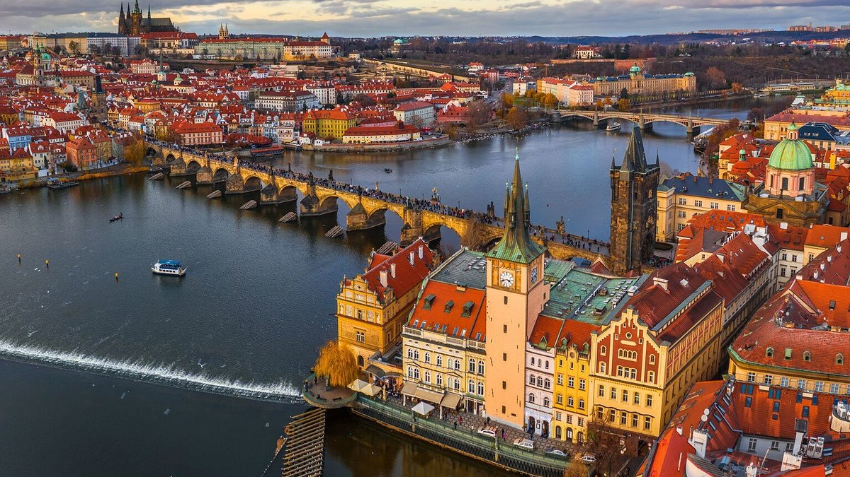
PRAGUE
The Ultimate Survival Guide

Slide 2
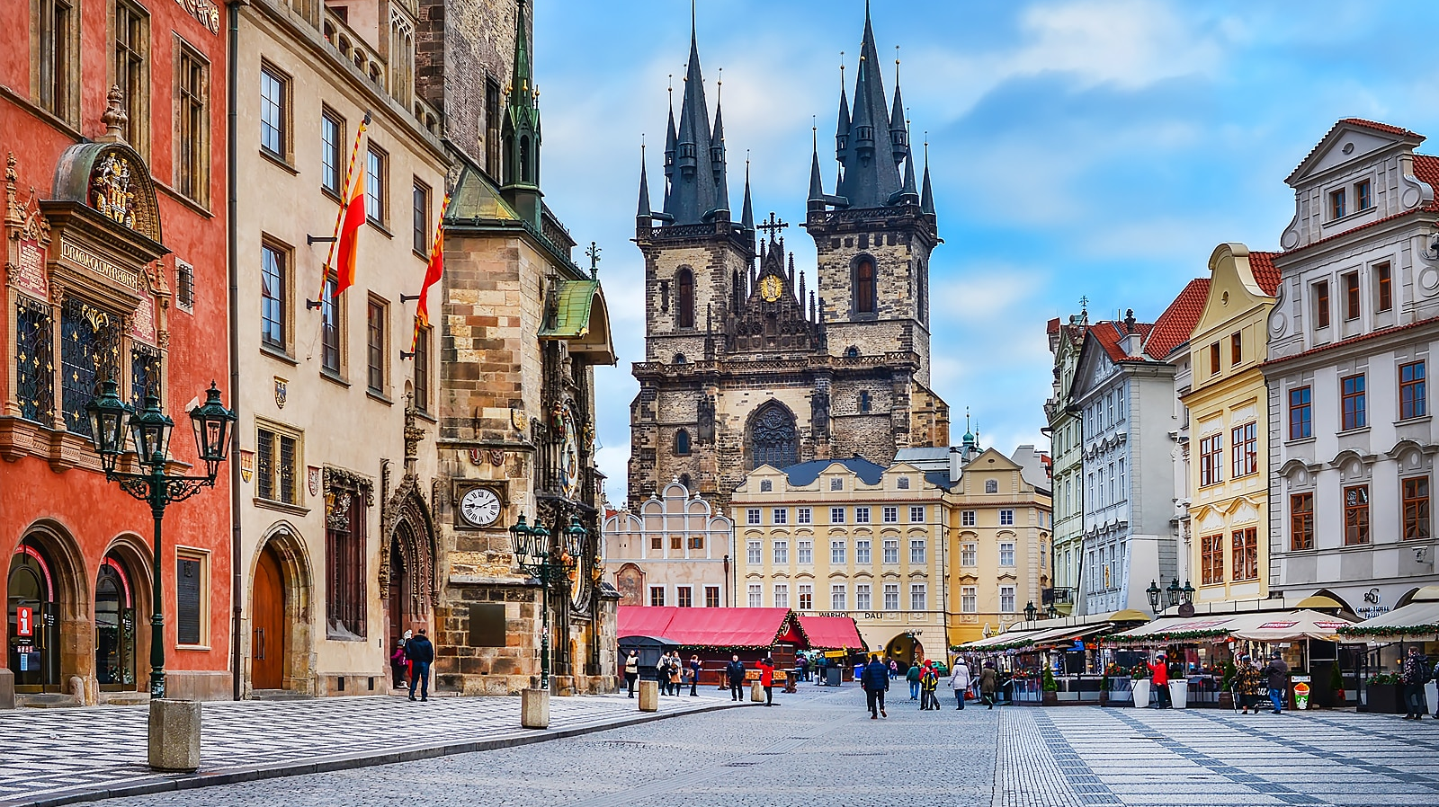
PRAGUE 101
Capital City of Czech Republic
„Praha“ in Czech, also known as „City of a Hundred Spires“ or „Mother of all Cities“
Located on the bank of Vltava river
Approximately 1.3 million inhabitants, 6–8 million visitors per year
The historic centre of Prague (which includes the Old Town, the Jewish Quarter, and the Lesser Town) is listed as a UNESCO World Heritage site since 1992

Slide 3
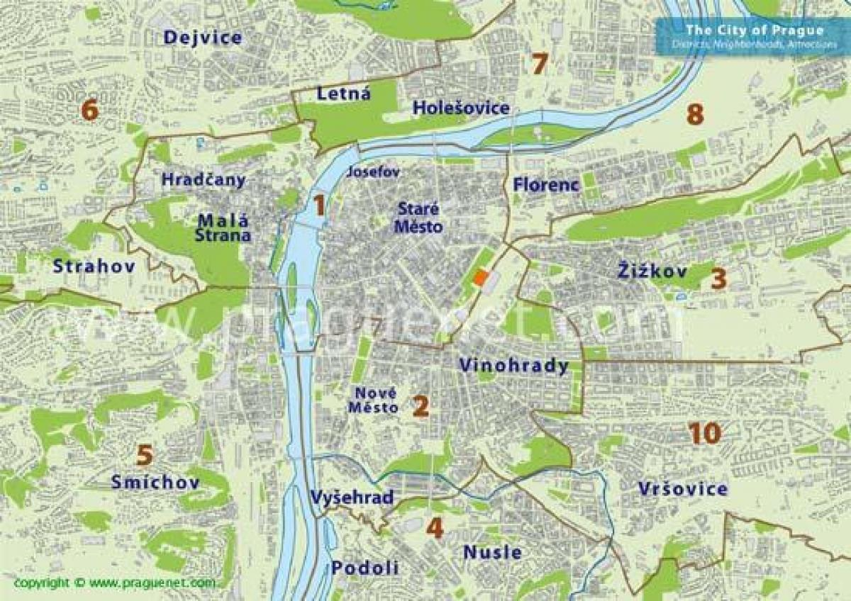
THE LAYOUT
22 districts, spiral
Prague 1- city centre
Prague 2- fancy residential area
Prague 8- Troja, our current location

Slide 4
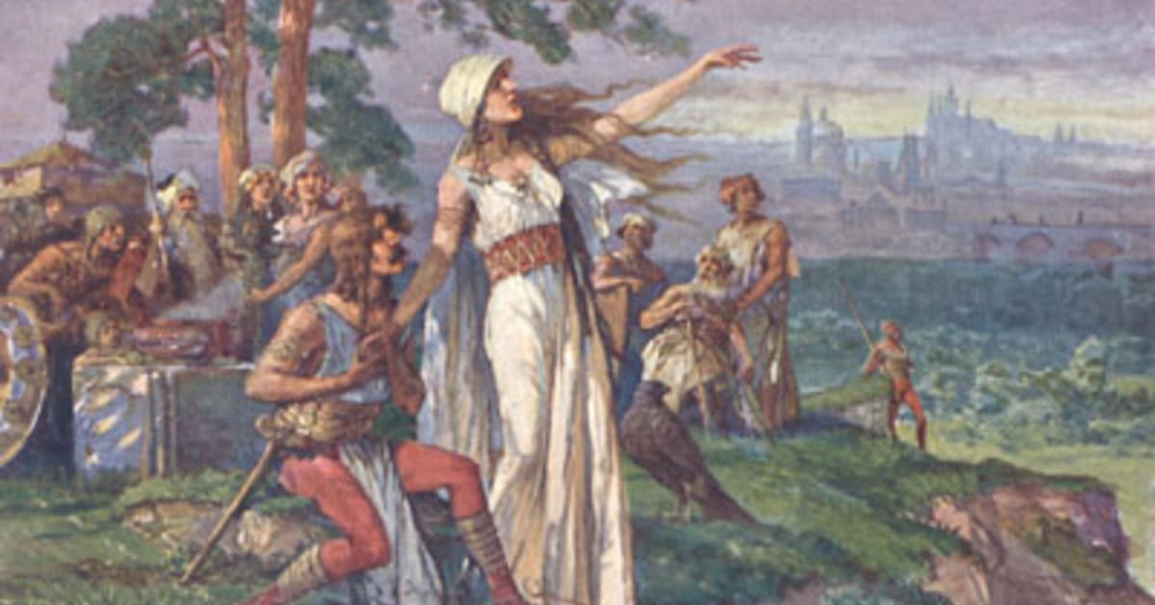
"I see a vast city, whose glory will touch the stars!“

Slide 5
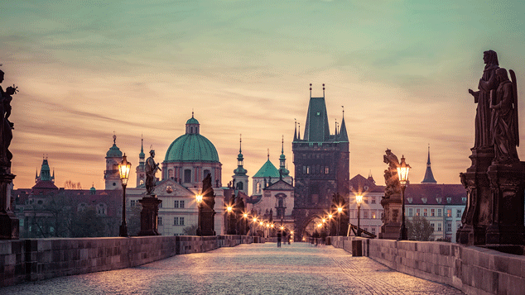
BIT OF HISTORY
Legend about Prague‘s founding – princess Libuše‘s prophecy
became the seat of the Přemyslid dynasty in the 9th century
cultural and trade centre during the middle ages
Importance grew in the 14th century during the reign of Karel IV. – Charles Bridge, St. Vitus Cathedral, and, of course, Charles University
Unique blend of Gothic, Renaissance and Baroque style

Slide 6
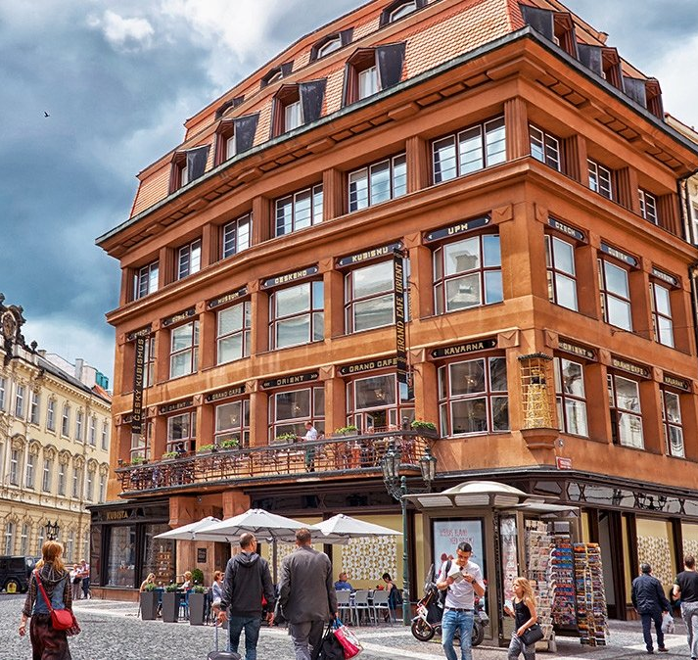
BIT OF HISTORY II.
More modern influences include art noveau (Municipal House) and cubism (House of the Black Madonna)
Prague Spring-> August 1968
1989- Wenceslas Square- student protests

Slide 7
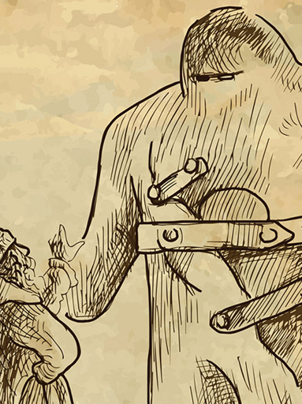
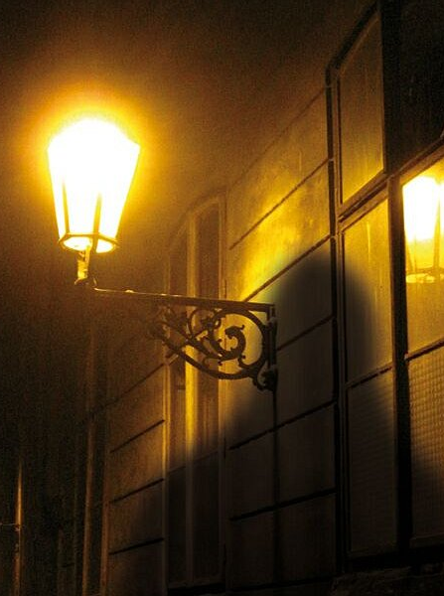
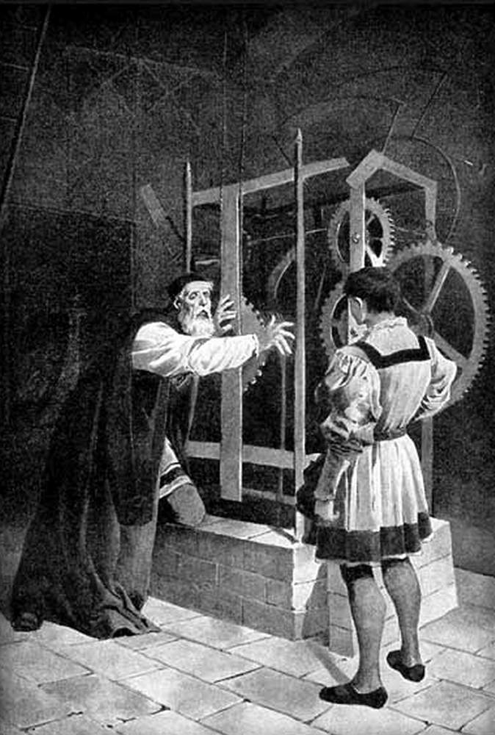
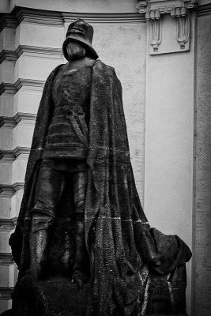

MYTHS AND LEGENDS
Golem- Jewish folklore- Rabbi Löw
Master Hanuš- builder of the astronomical clock
Several Prague ghosts: Headless Templar, Murdered Nun

Slide 8
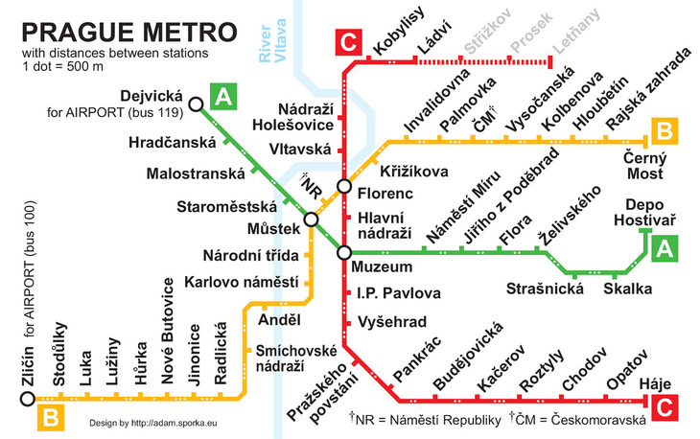
PRAGUE‘S TRANSPORTATION SYSTEM

Slide 9
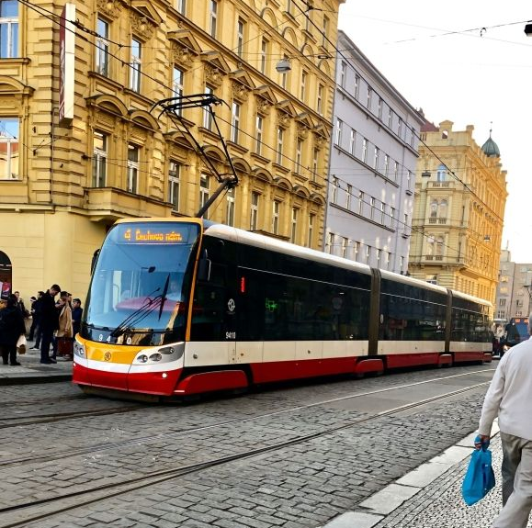
Metro- 3 lines- A, B, C,
3 transfer stations (Můstek, Florenc, Muzeum), all in the centre
Trams- go mostly through the city centre
Buses- going to the outskirts, can get stuck in traffic during rush hour
City centre is pretty walkable if you can avoid tourists
Cycling is not recommended (too hilly and too many cars)

Slide 10
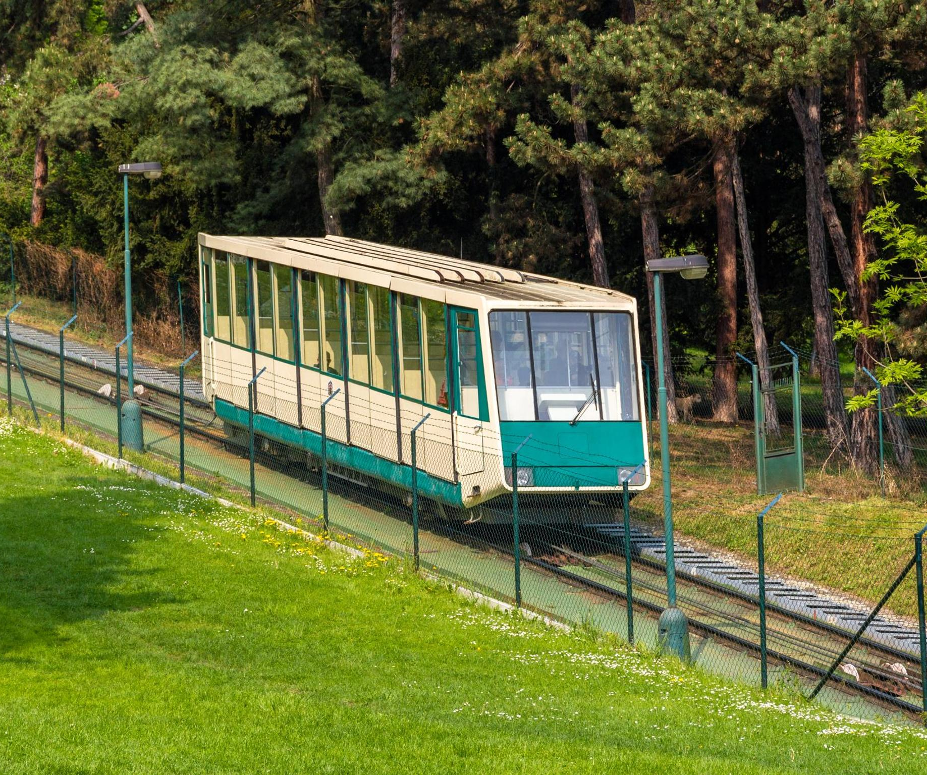
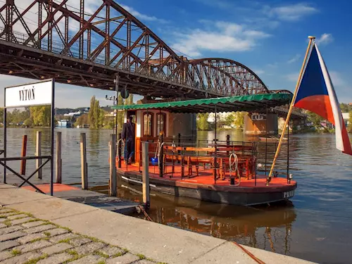
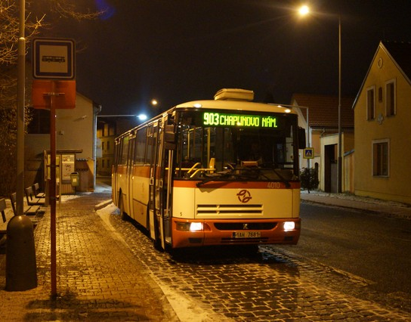
Your tavel card also allows you to use riverboats on Vltava River
Find more info on https://pid.cz/en/riverboats/
There is also a funicular that gets you on top of Petřín Hill https://pid.cz/en/?s=funicular
Night buses (the 900s) and trams are also pretty reliable
Uber or Bolt is always an option

Slide 11

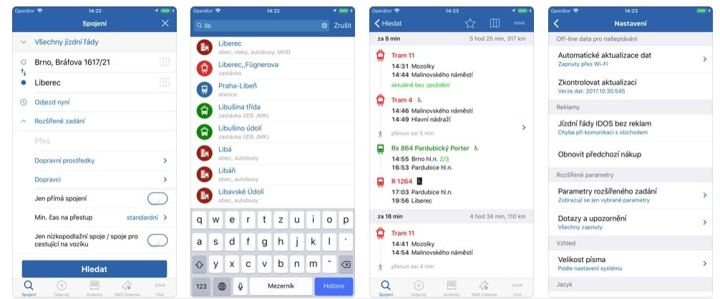
Use IDOS App or https://idos.idnes.cz/pid/spojeni/ for finding out the fastest route from station A to station B

Slide 12
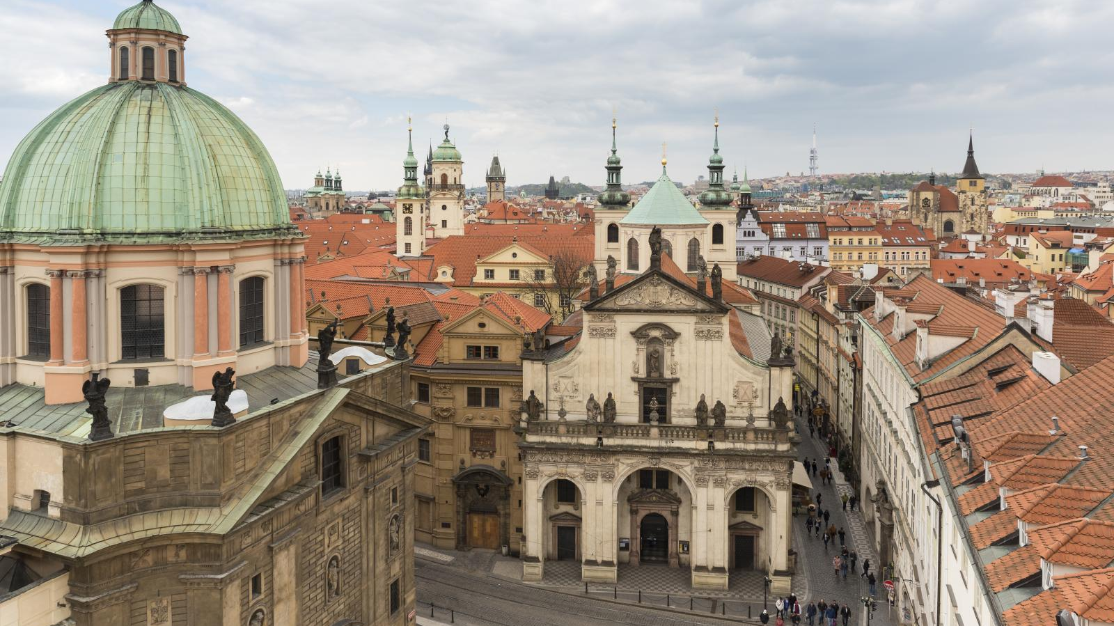
THE BY-NO-MEANS- EXHAUSTIVE LIST OF SIGHTS
Old Town Square (Staroměstské náměstí)
Wenceslas Square (Václavské náměstí)
Jewish Quarter
Charles Bridge
St. Nicholas Church
Prague Castle
Petřín Hill
Vyšehrad
Lenon Wall
Square of the Republic with Municipal House

Slide 13
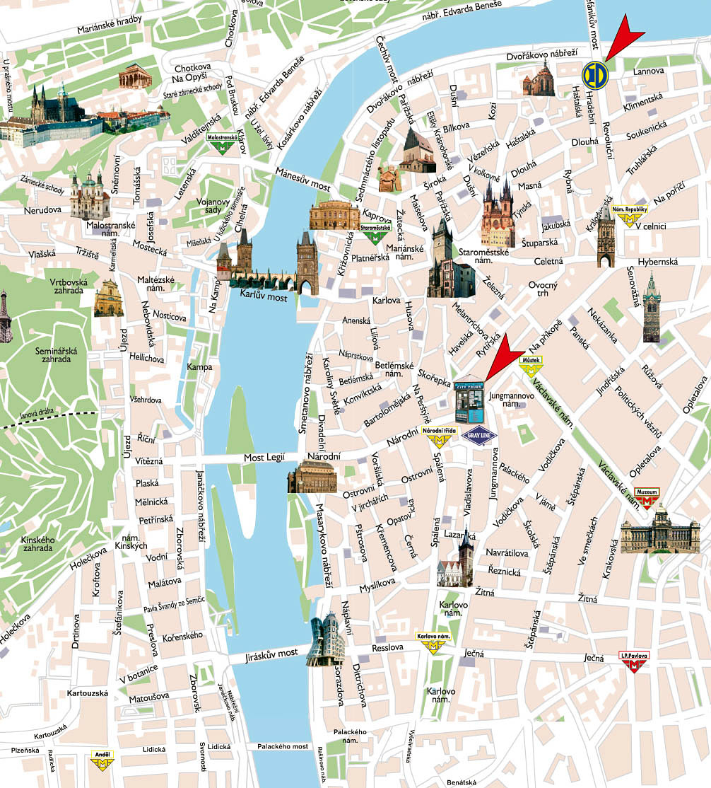

Slide 14
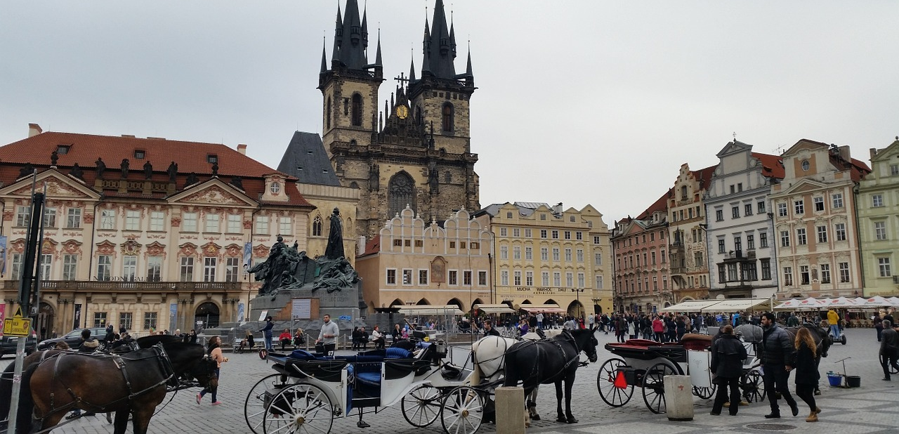
OLD TOWN SQUARE
How to get there: tram 17 to Právnická Fakulta then walk through Pařížská Street
What to see there: Týnský Church, Old Town Hall with Astronomical Clock

Slide 15
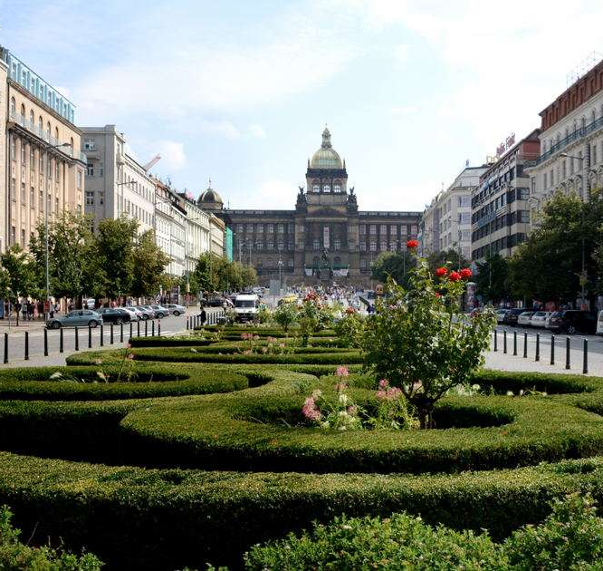
WENCESLAS SQUARE
How to get there: Muzeum stop on the C + A line or Můstek on B + A line
What to see there: Czech National Museum, lots of shops and cafés, Světozor and Lucerna cinemas, largest club in Prague
Popular spot for protests
„Pod koněm“ (literally: under the horse)- popular meeting spot for locals

Slide 16
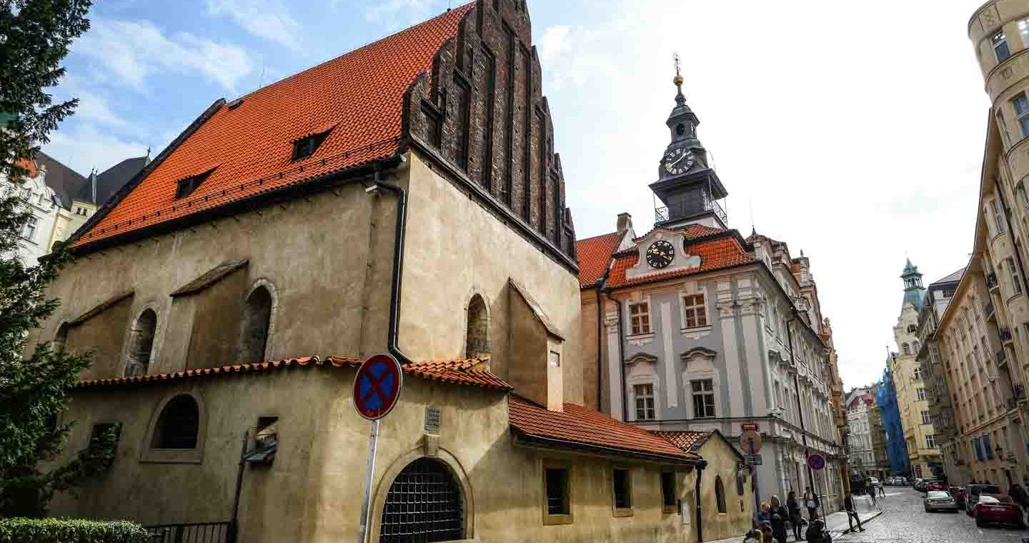
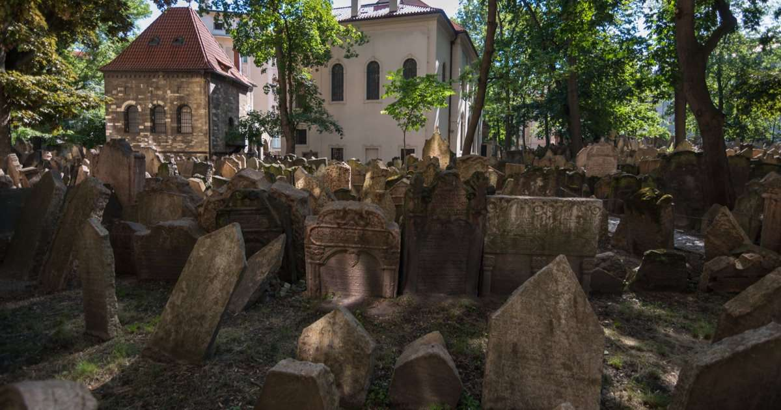
JEWISH QUARTER
How to get there: tram 17 or metro line A to Staroměstská
What to see there: Old-New Synagogue, Pinkas Synagogue- holocaust memorial
Jewish Museum
Jewish Cemetery

Slide 17
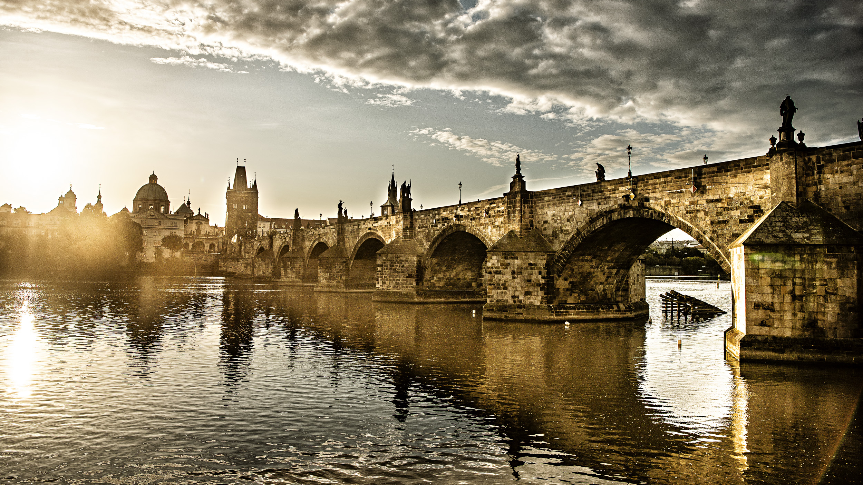
CHARLES BRIDGE
How to get there: tram 17/metro line A to Staroměstská
Tip: go early in the morning

Slide 18
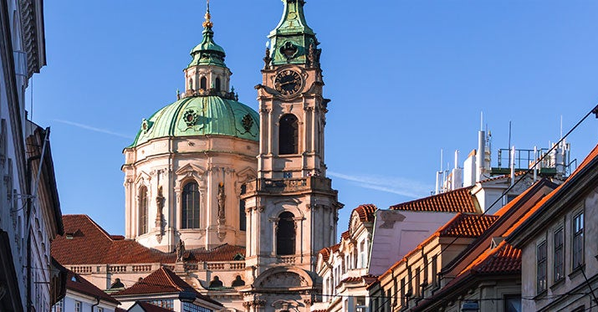
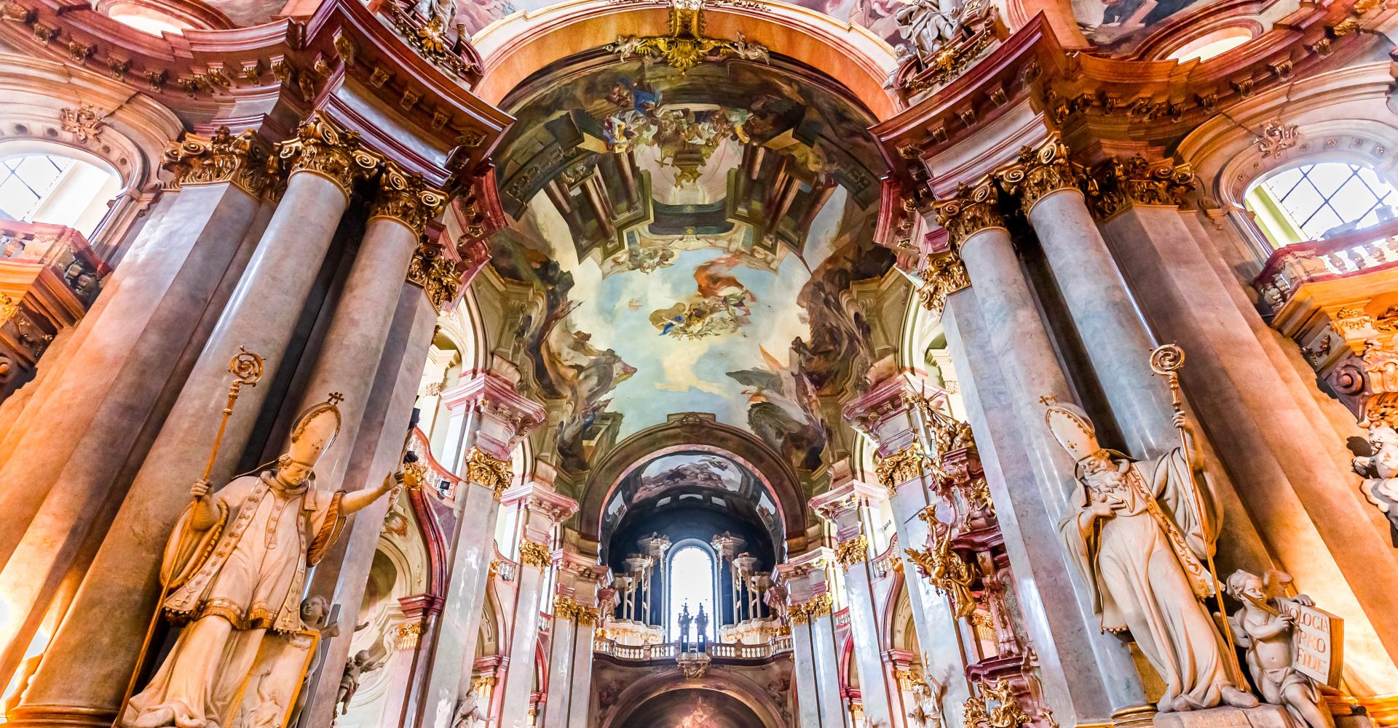
How to get there: cross Charles Bridge to get to Lesser Town or get off at Malostranská metro line A stop
One of the largest baroque churches in Europe, tallest interior in Prague
ST. NICHOLAS CHURCH

Slide 19
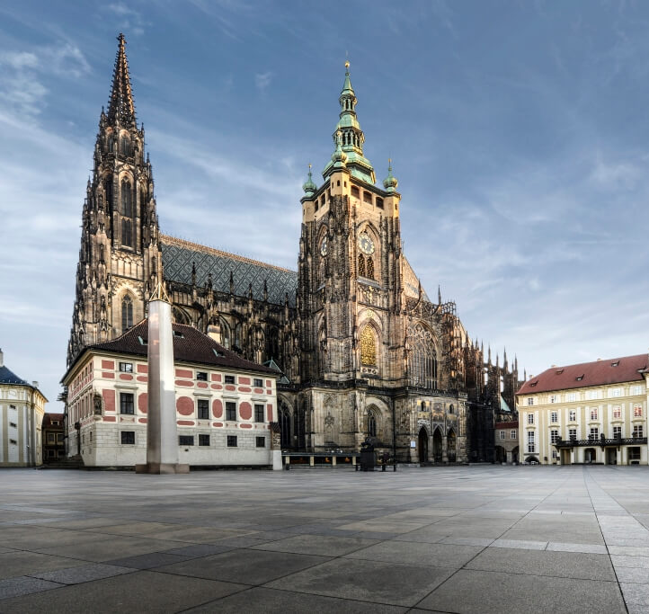
PRAGUE CASTLE
How to get there: take the castle stairs at Malostranská (line A) or tram 22, 23- Pražský Hrad stop
Largest castle complex in the world
St. Vitus Cathedral
Golden Lane

Slide 20
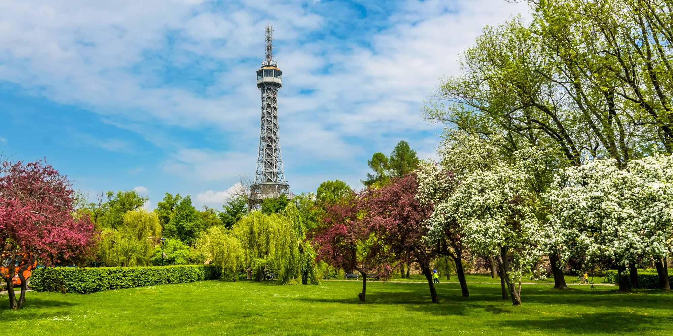
PETRIN HILL
How to get there: tram 15, 20, 12 to Újezd, then walk up or take the funicular
Tip: great view and great place for a picnic

Slide 21
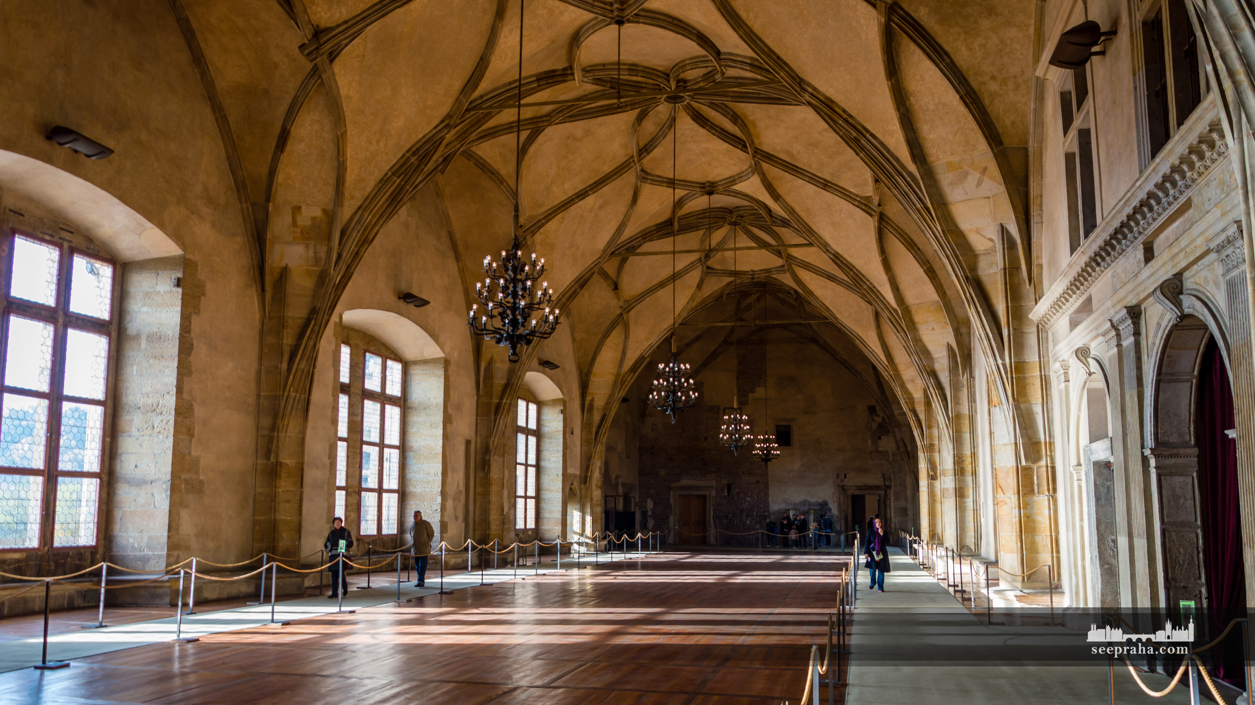
GENERAL TIPS & RECOMMENDATIONS

Slide 22
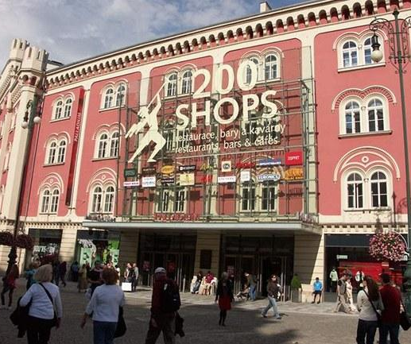
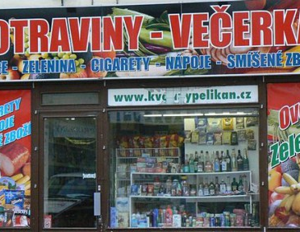
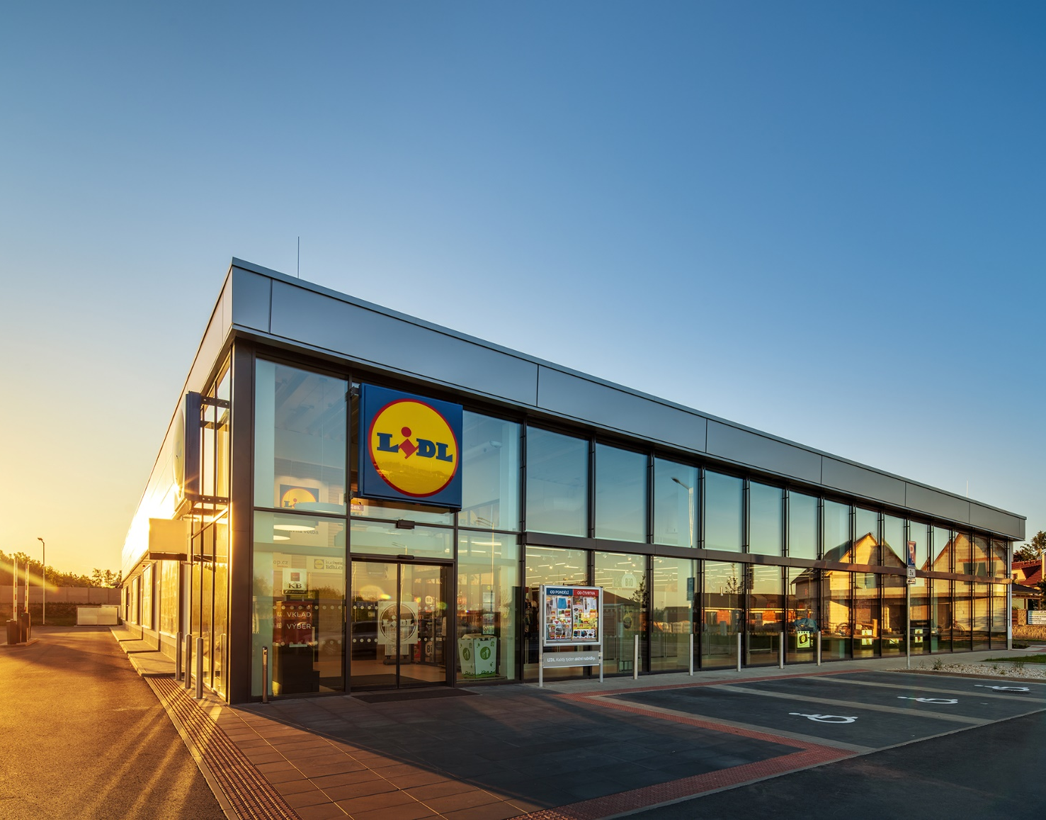
Open daily including Sundays
Supermarkets– Lidl, Albert, Billa – affordable, Delmart- fancy, Sklizeno – vegetarian, vegan options
„Večerky“ – convenience stores, almost always open
Shopping Malls- Palladium, OC Černý Most, OC Letňany Westfield Chodov – clothes shops, cinemas, bookstores, cafés
Sapa- „Little Hanoi“ Vietnamese market, Asian food
SHOPPING
IN PRAGUE

Slide 23

CULTURE & EVENTS
Arthouse cinemas: Atlas, Světozor, Lucerna, Aero – English Screenings
English friendly theatre: Prague Shakespeare Company, Cimrman English Theatre
Skautský Institut, Kasárny Karlín- events, workshops, movie screenings English conversation club, dancing lessons, debate club
One World Festival- a huge festival of documentary films from all around the world, includes Q&A sessions with interesting guests (directors, civil right activists)- at the end of March
https://www.oneworld.cz/

Slide 24

Charles University Debate Club (DKUK)
One of the few Charles University Club‘s that is not tied to any specific faculty, 100 % English-friendly
Weekly debate meetings on Wednesday evenings – British Parliamentary Style (& pub afterwards)
https://www.dkuk.cz/en
Facebook: https://www.facebook.com/vsdebata

Slide 25
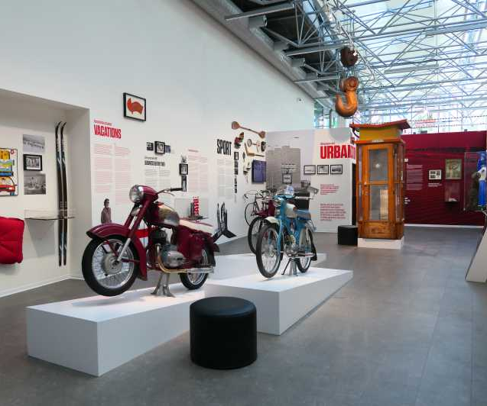
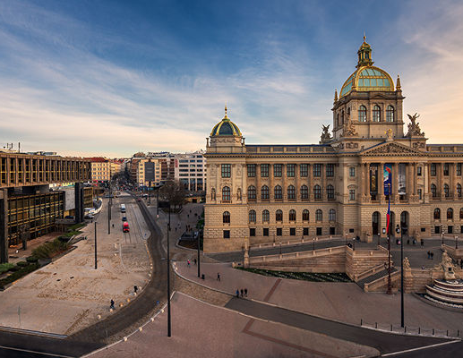
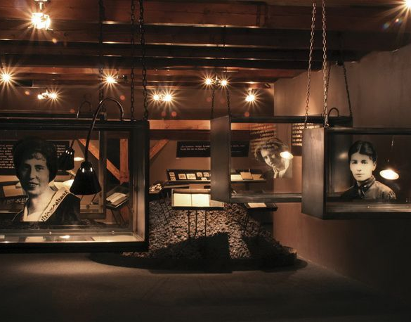
MUSEUMS
Czech National Museum
Kafka‘s Museum
Museum of Prague Ghosts and Legends
Museum of Communism

Slide 26
GALLERIES
Kunsthalle- free entry for students
Veletržní Palác- 20th and 21st century art
DOX
Museum Kampa

Slide 27
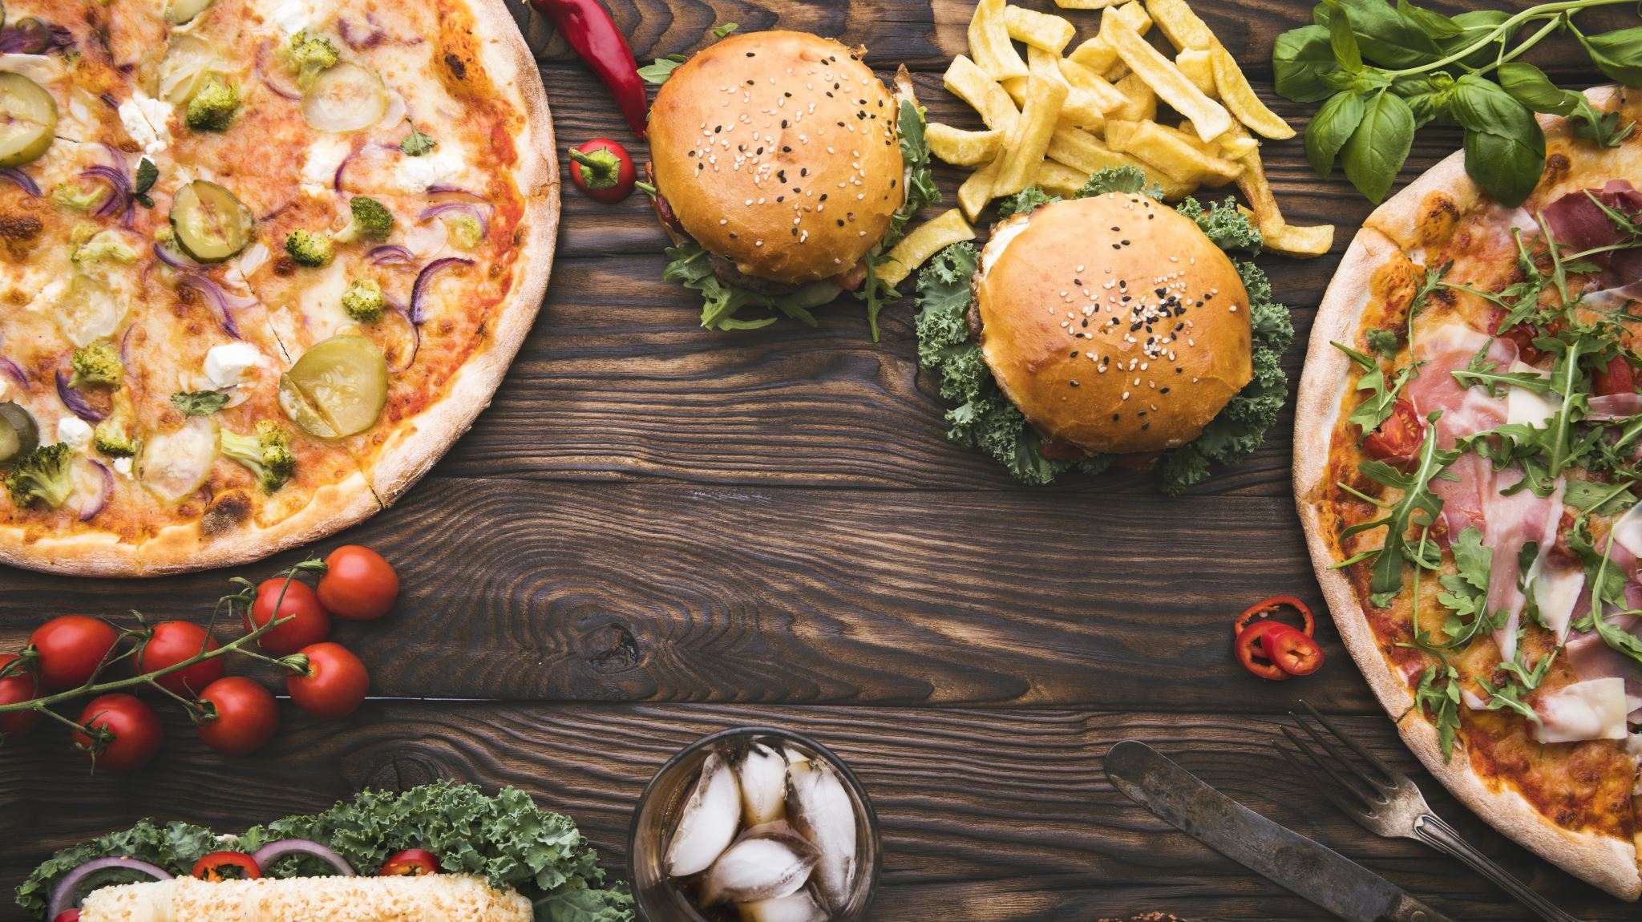
FOOD & DRINKS
Mamacoffee, Dobrá Trafika, Kavárna Co Hledá Jméno, lots of „čajovny“- places that serve tea
Náplavka- embankment of Vltava river, popular student hang-out spot, lots of small bars on boats
‘Pivovar u Fleků’ - oldest pub in Prague
Restaurace U Pinkasů, Hybernia, Potrefená Husa- traditional Czech food
Quick bite: Bageterie Boulevard, Ugo, Dhaba Beas (40 % discount 1 hour before closing time)

Slide 28
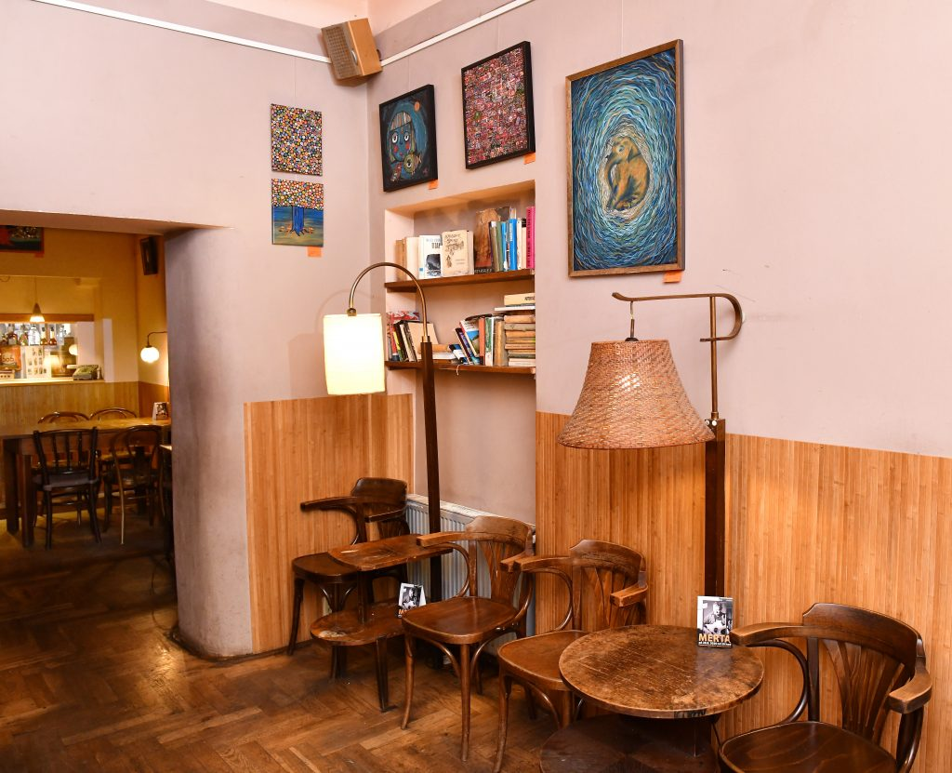



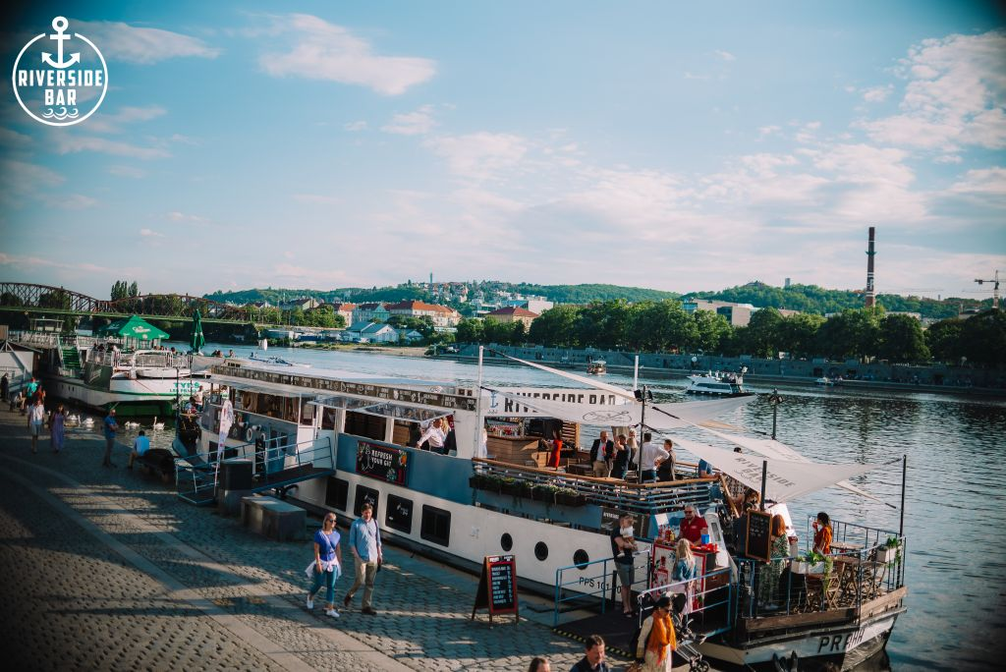
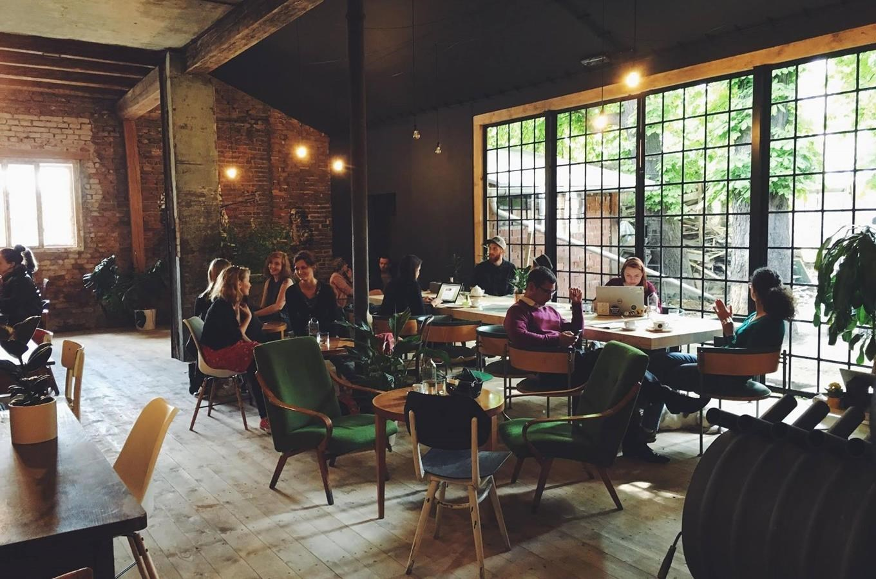

Slide 29
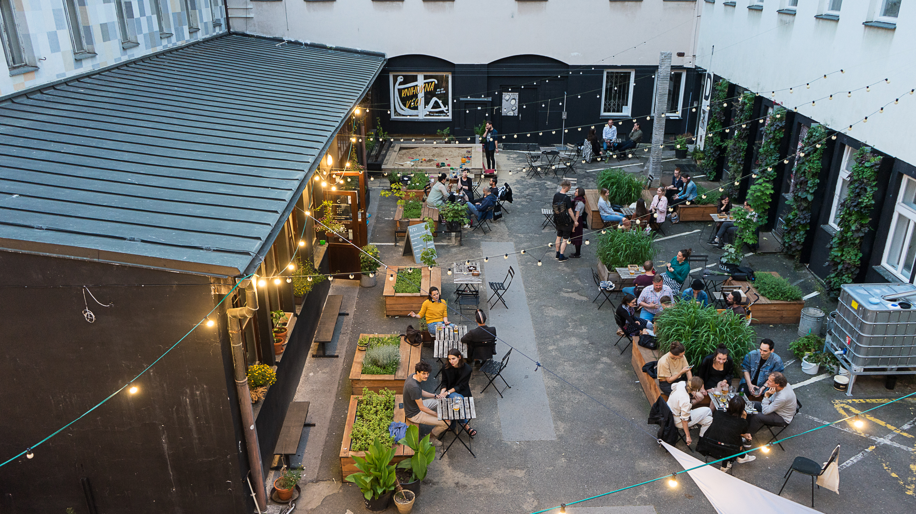
PRAGUE FOR STUDENTS
Campus Hybernská- café & workshops, university WiFi
NTK- National Technical Library in Dejvice (24/7)
Cafedu
Czech Academy of Sciences Library
FHS Library, ig: @knihovnavkostce
ISIC discounts (UGO, BB, bookshops, ČD train service)

Slide 30
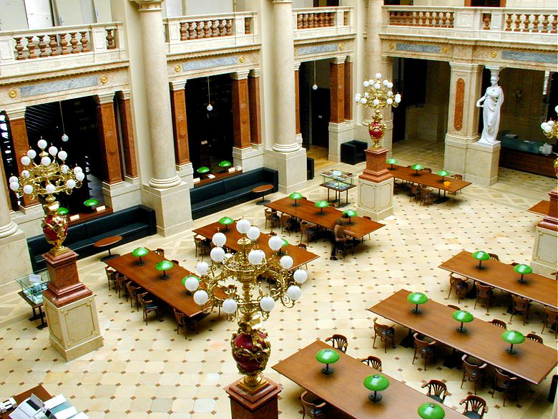
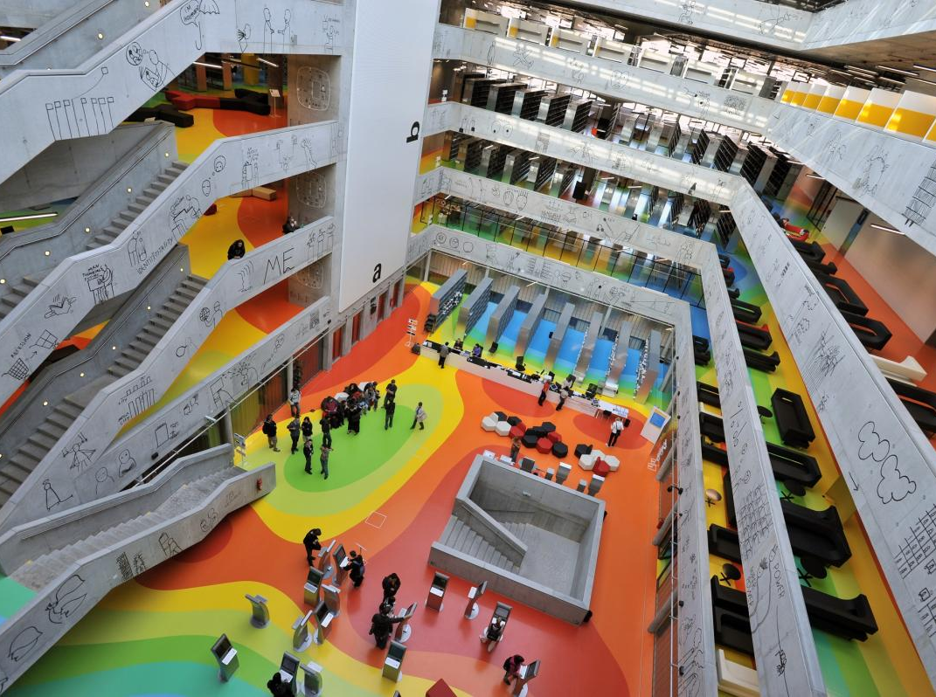
NTK- National Technical Library,
Dejvická (metro A)
Library of AV CR (Academy of Sciences), Národní Divadlo (tram 17)
100 CZK for a semester

Slide 31
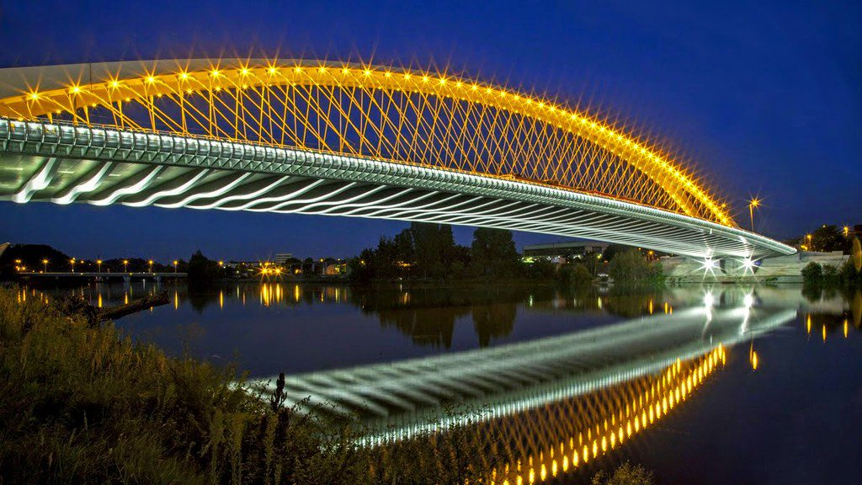
TRÓJA
Where to go near the faculty

Slide 32
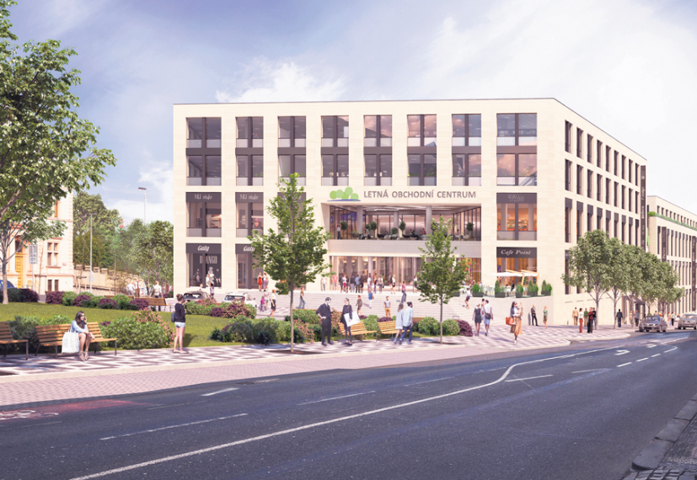
take tram 17 to Strossmayerovo Náměstí:
Cafés: Kafe Francin, Ouky Douky
Restaurants: Forky‘s (popular vegetarian burgers), Loving Hut (vegan buffet), Bageterie Boulevard
Shopping Mall: OC Stromovka (supermarket, stationery, food court)- tram 17 to Veletržní Palác
Cross Club near Nádraží Holešovice (tram 17 or cross the bridge)

Slide 33
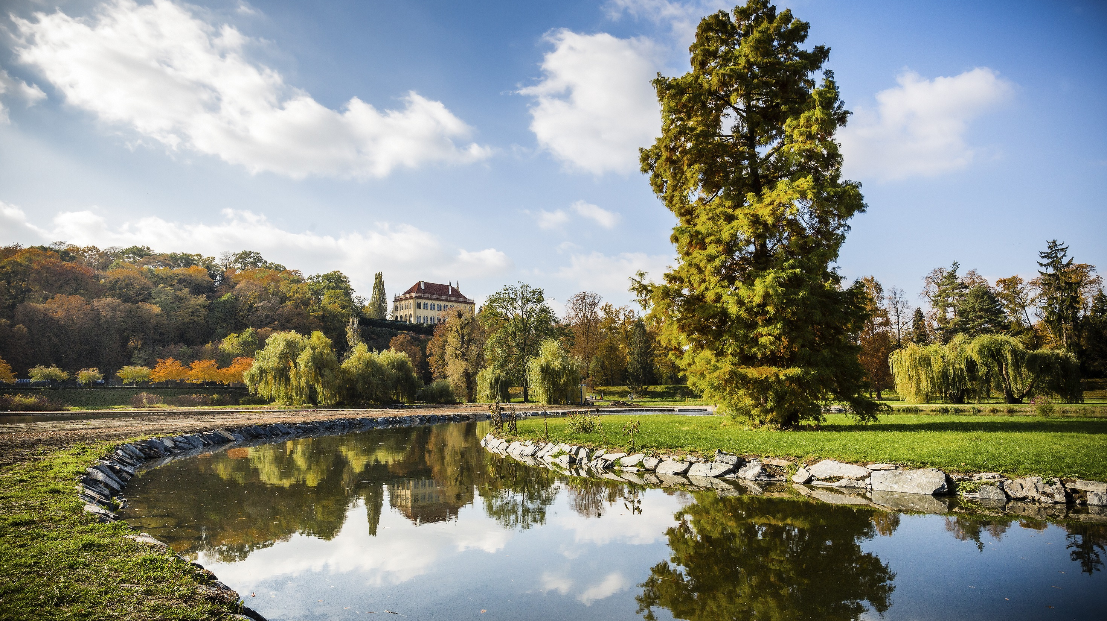
PARKS NEAR
THE FACULTY
Stromovka Park – popular hang out spot (tram no. 17 to Veletržní Palác)
Letná Park (from Strossmayerovo náměstí)

Slide 34
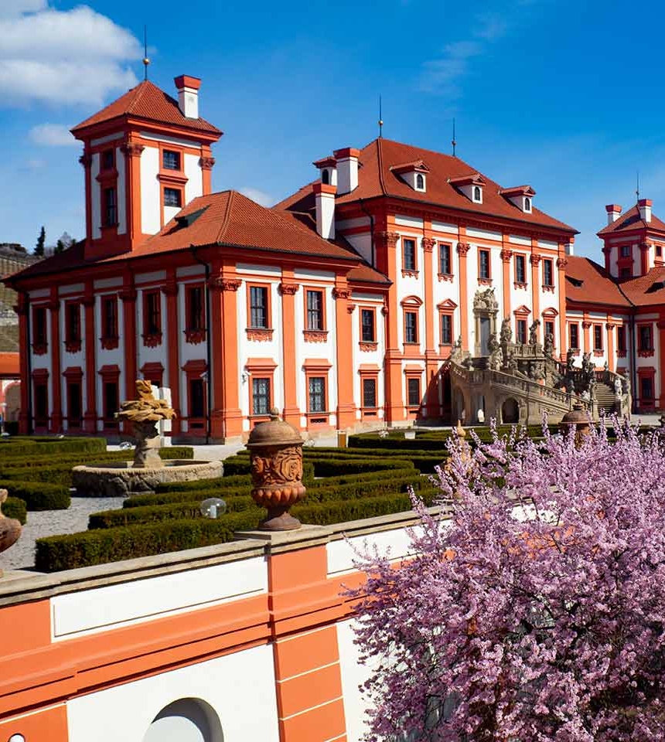
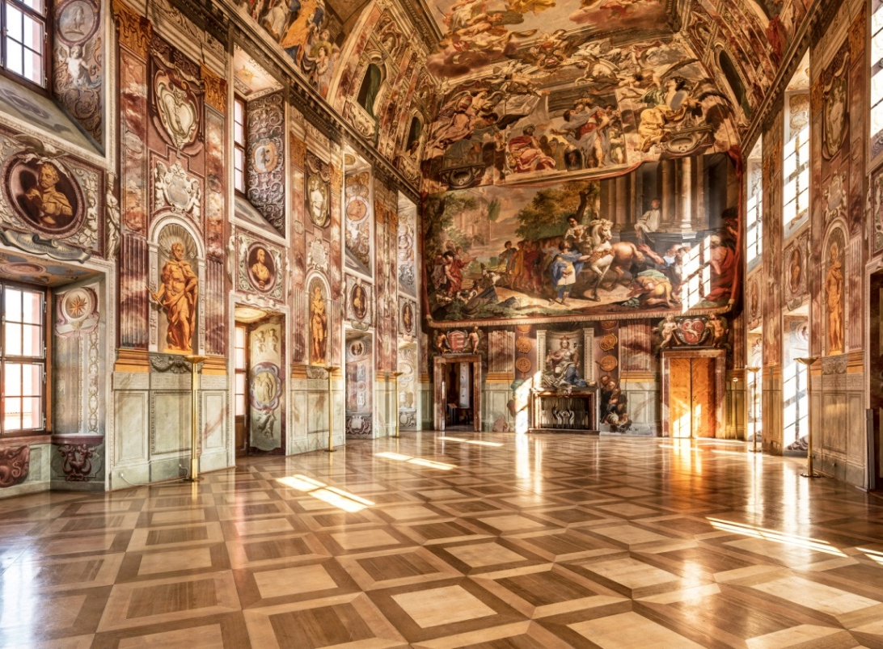
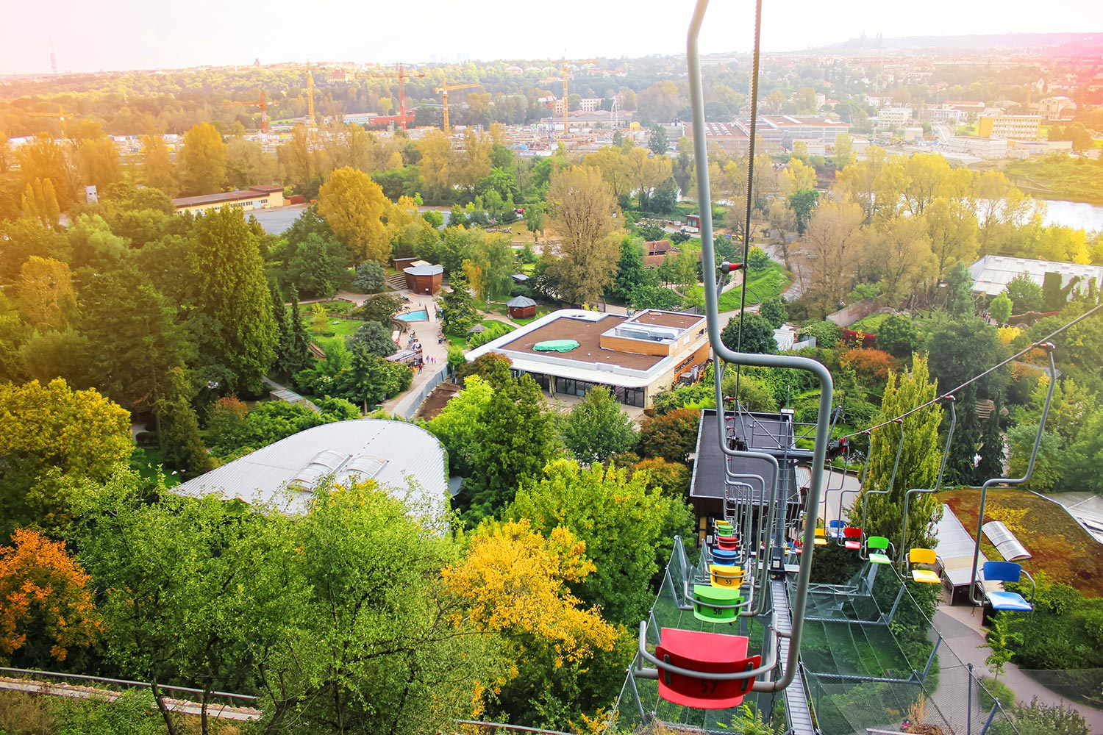
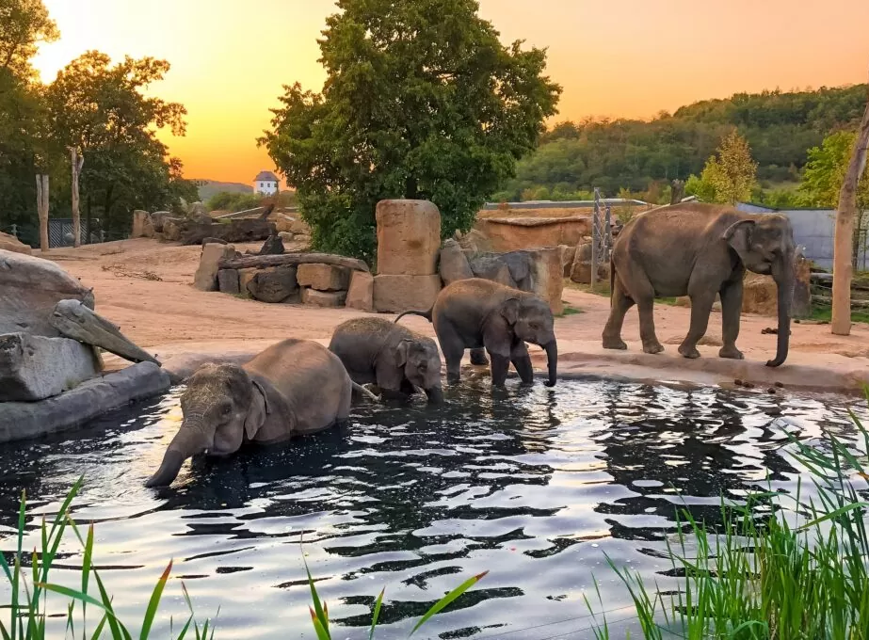
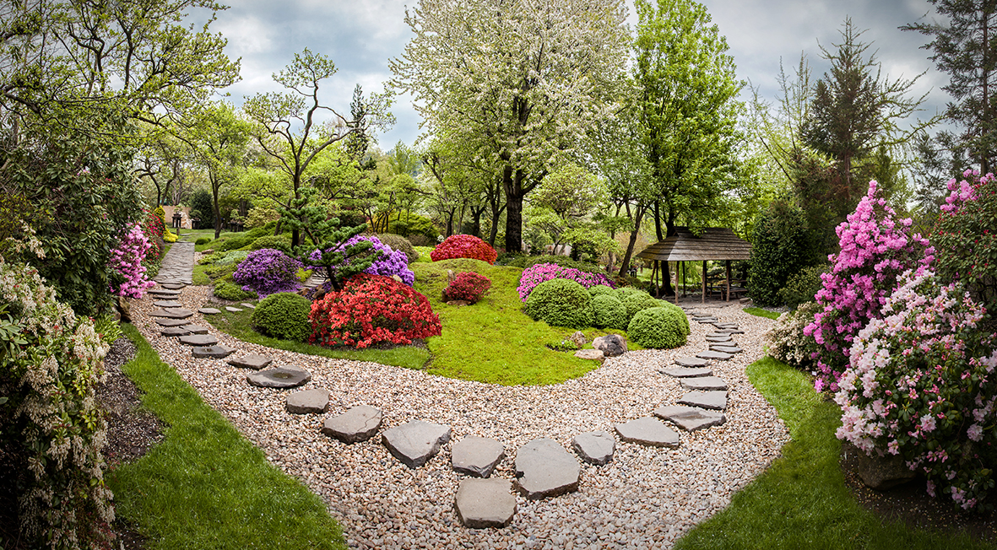
SIGHTS NEAR
THE FACULTY
Bus no. 112 from Povltavská or Trojská bus stop near our faculty to Zoologická Zahrada stop
Prague Zoo
Prague Botanical Garden
Troja Castle (underrated!)

Slide 35
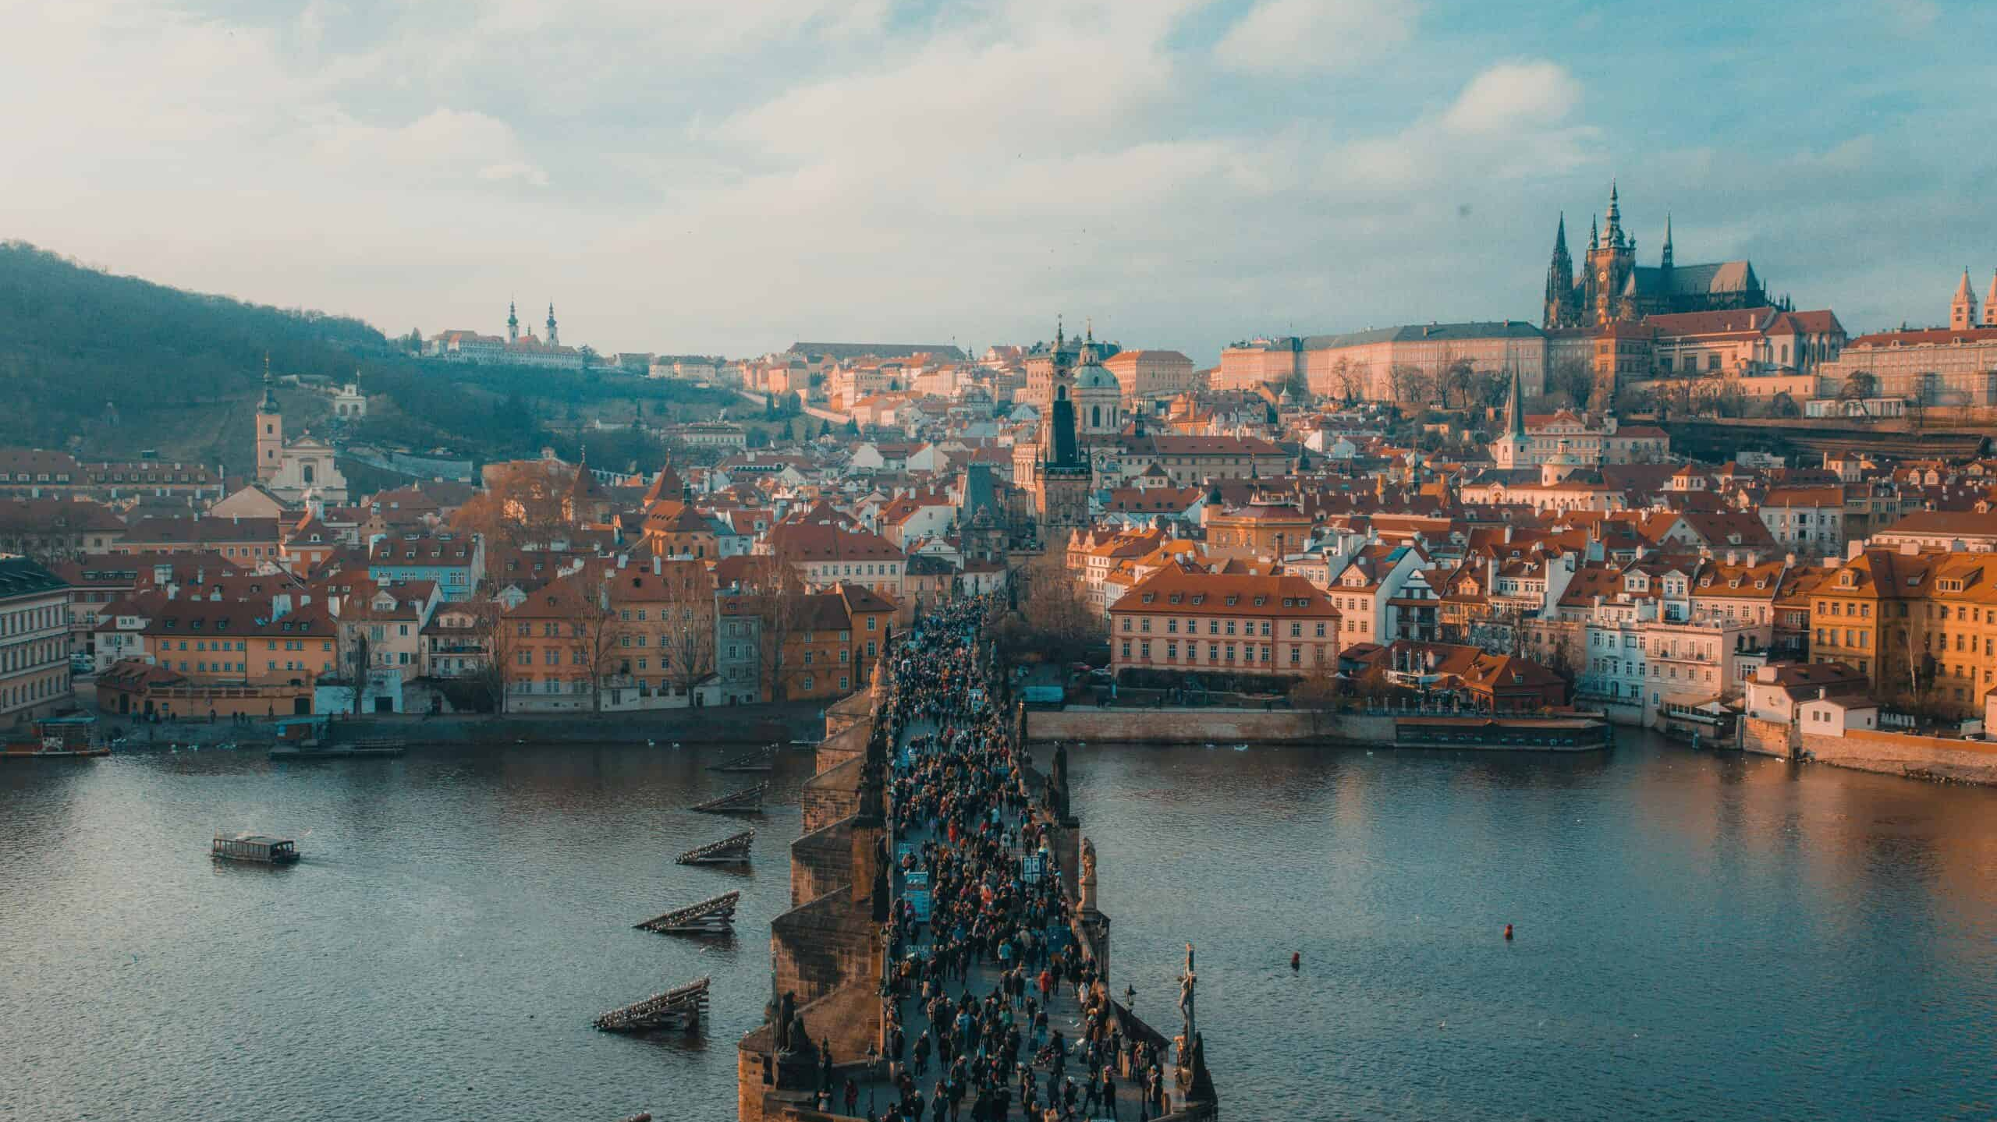
USEFUL LINKS
Honest Guide youtube channel: https://youtube.com/@HONESTGUIDE
Like a local guide: https://www.likealocalguide.com/prague
Use It travel guide https://www.use-it.travel/cities/detail/prague/
Foodie map (paid): https://www.tasteofprague.com/prague-foodie-map
Gastromapa: https://gastromapa.hejlik.cz

